Slide 1
Data Analyst Apprenticeship
Level 4 (HNC)
COURSE INDUCTION
January 2025

Slide 2
Martin Reid
Apprenticeship Programme Manager Course Leader for:
Computing Foundation Level 4 Data Analyst Apprenticeship HNC (HTQ 2024) Data Analyst BSc (Hons) Digital and Technology Solutions (Apprenticeships), Office: JM506
martin.reid@solent.ac.uk

Slide 3
KENTON WHEELER
Associate Lecturer in Computing
Office: JM506
kenton.wheeler@solent.ac.uk

Slide 4
Welcome
East Park Terrace Campus
Apprenticeship Standard
KSBs
Support & Communication
Review Meeting
Teaching Delivery
Study Days
Academic Calendar
Off-The-Job-Tracker
Solent Portal
Timetabling & Attendance Monitoring
Assessments & Grading
EPA & Portfolio
Student Course Representatives
Q & A

Slide 5
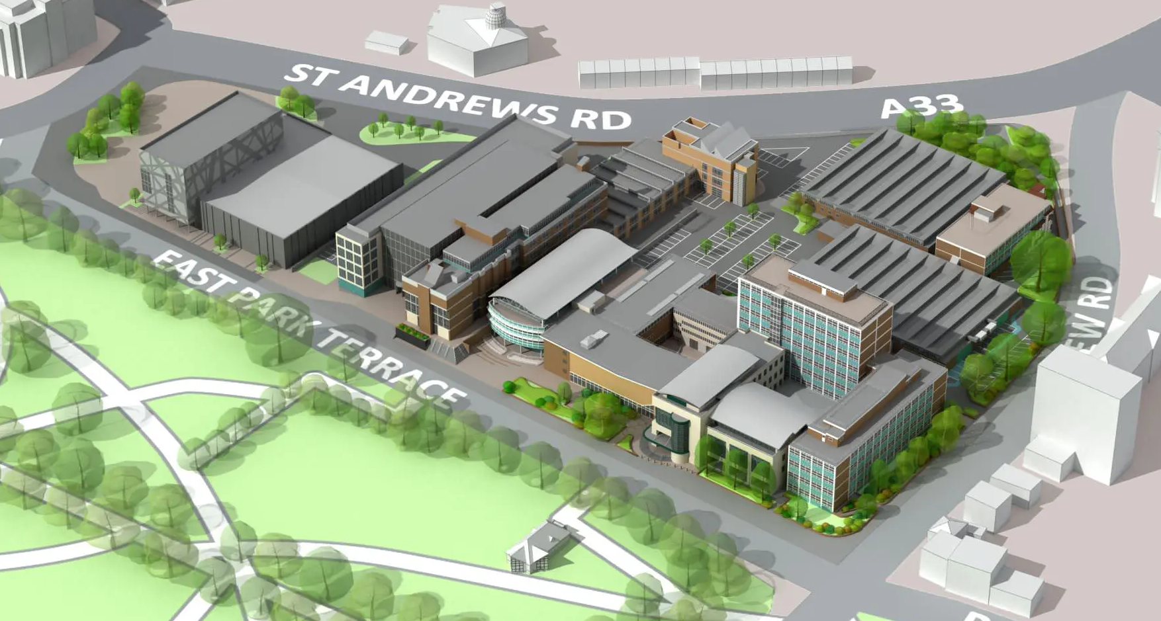
EAST PARK TERRACE CAMPUS

Slide 6
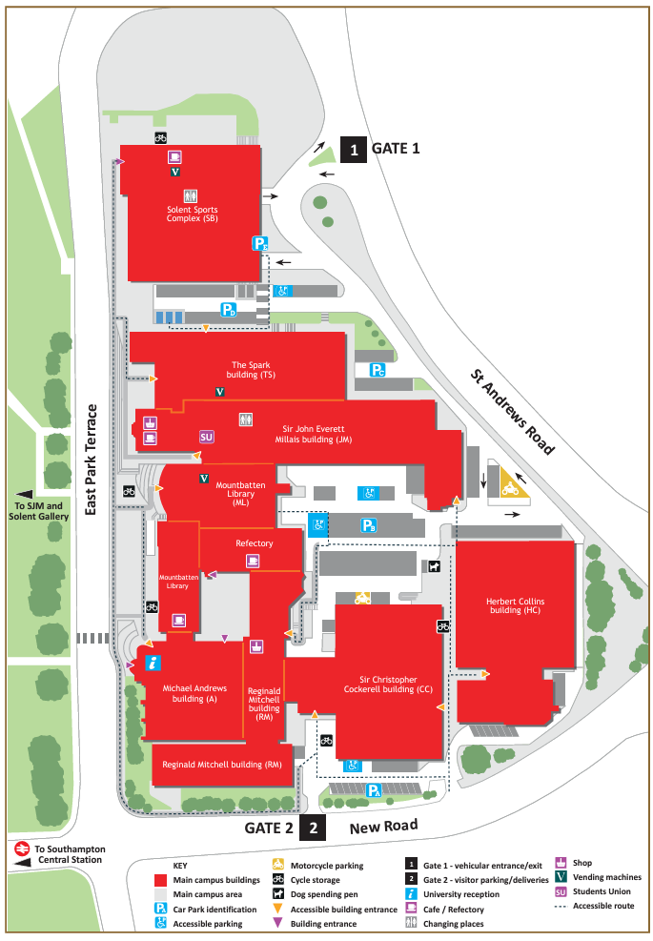
https://www.solent.ac.uk/about/documents/southampton-city-centre-map.pdf

Slide 7
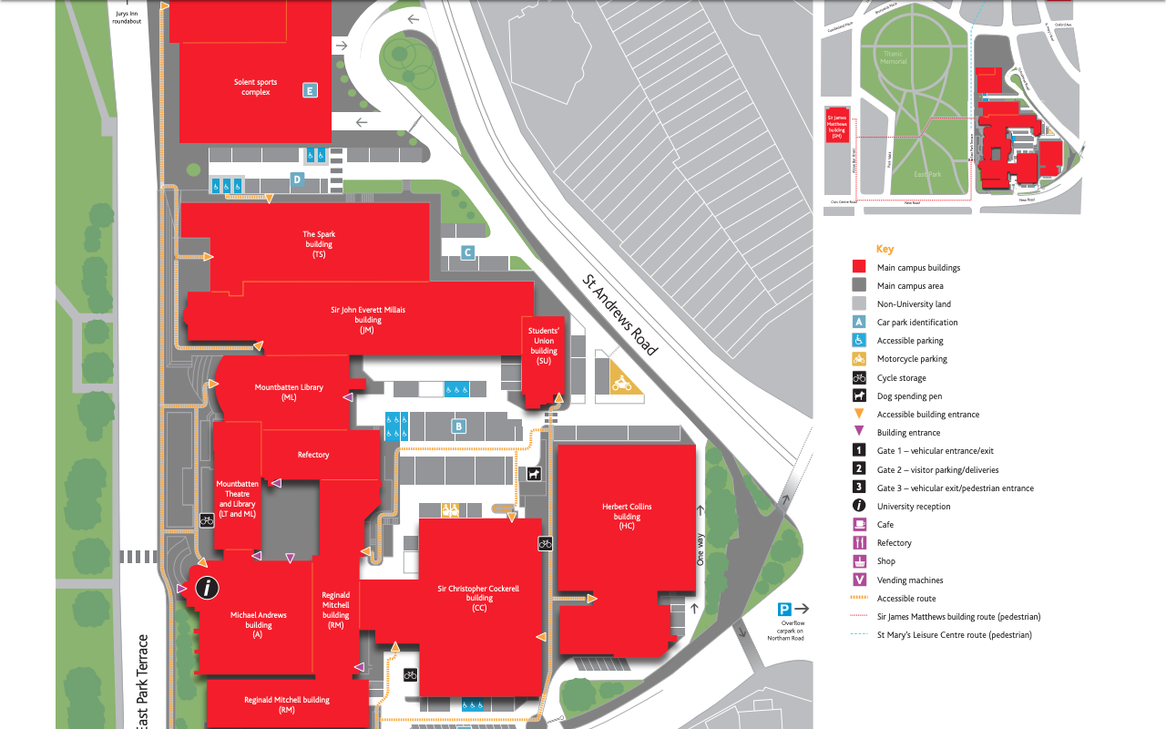
JM Building
Computing Staff Team
JM506
Students
Union

Slide 8
Apprenticeship Standard

Slide 9
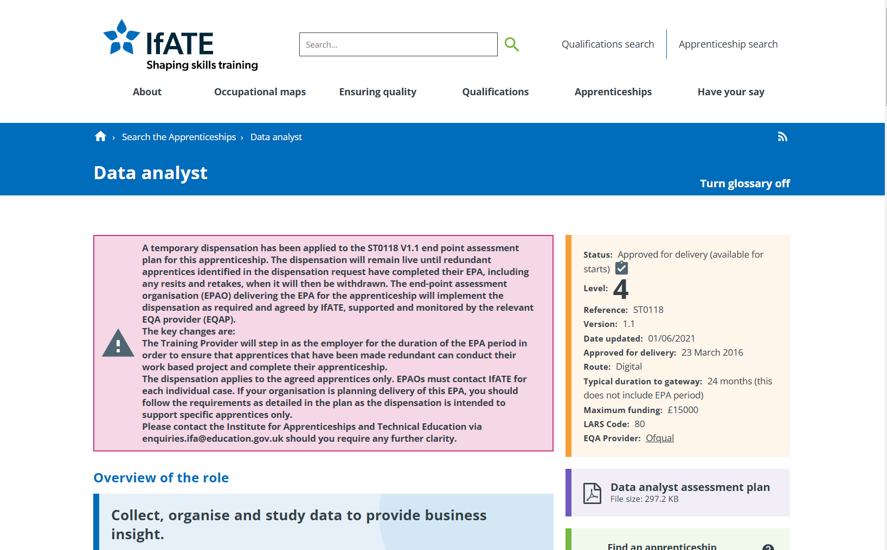

Slide 10
KSBs
KNOWLEDGE SKILLS BEHAVIOURS

Slide 12
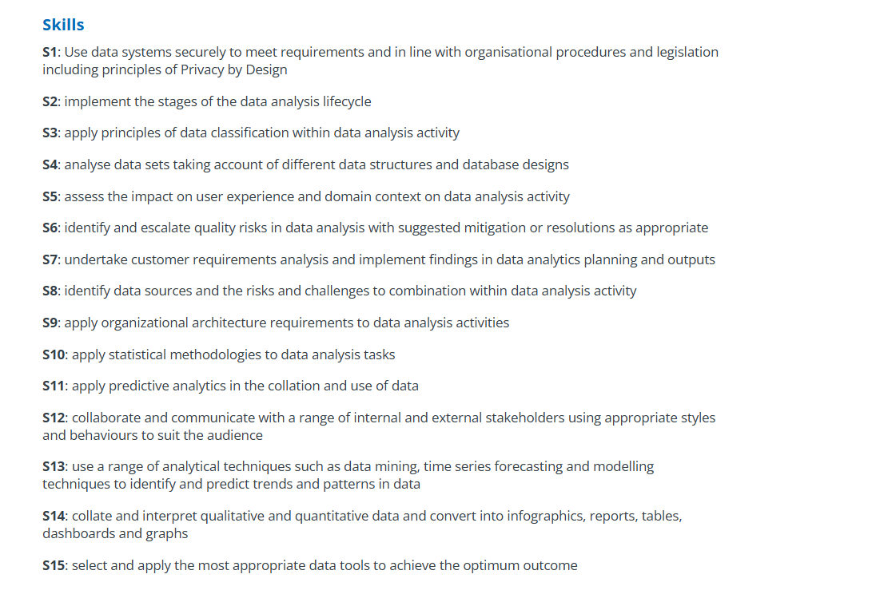

Slide 13
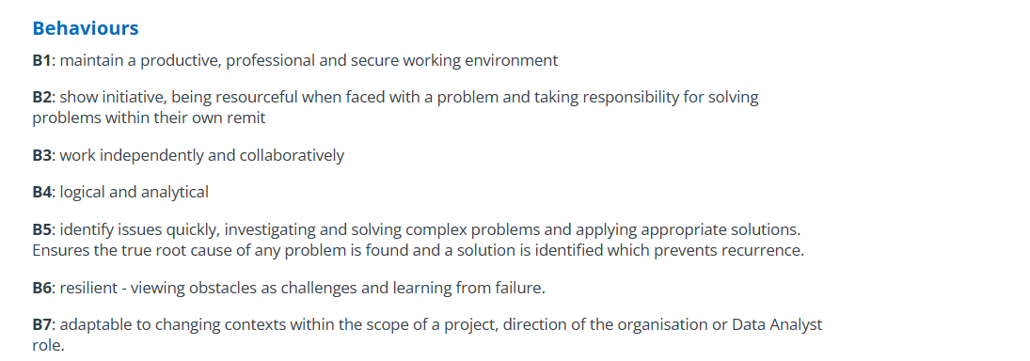

Slide 14
Support & Communication

Slide 15
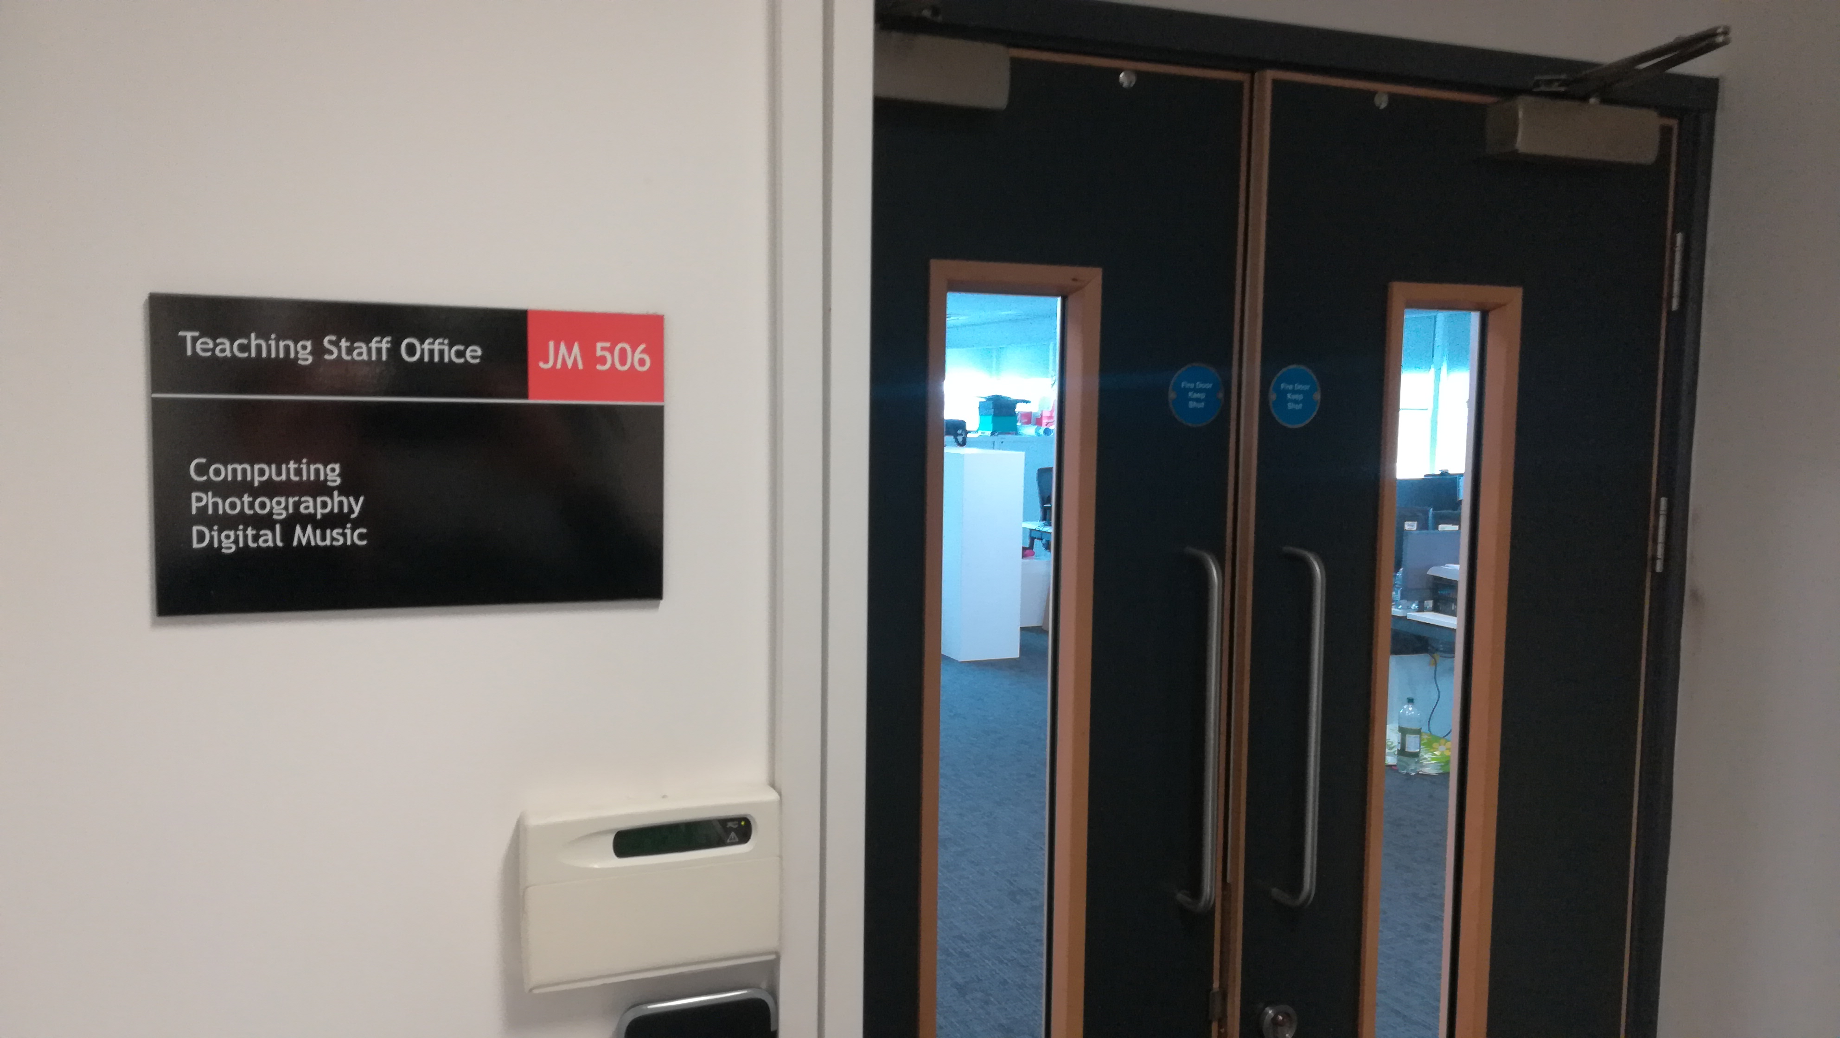
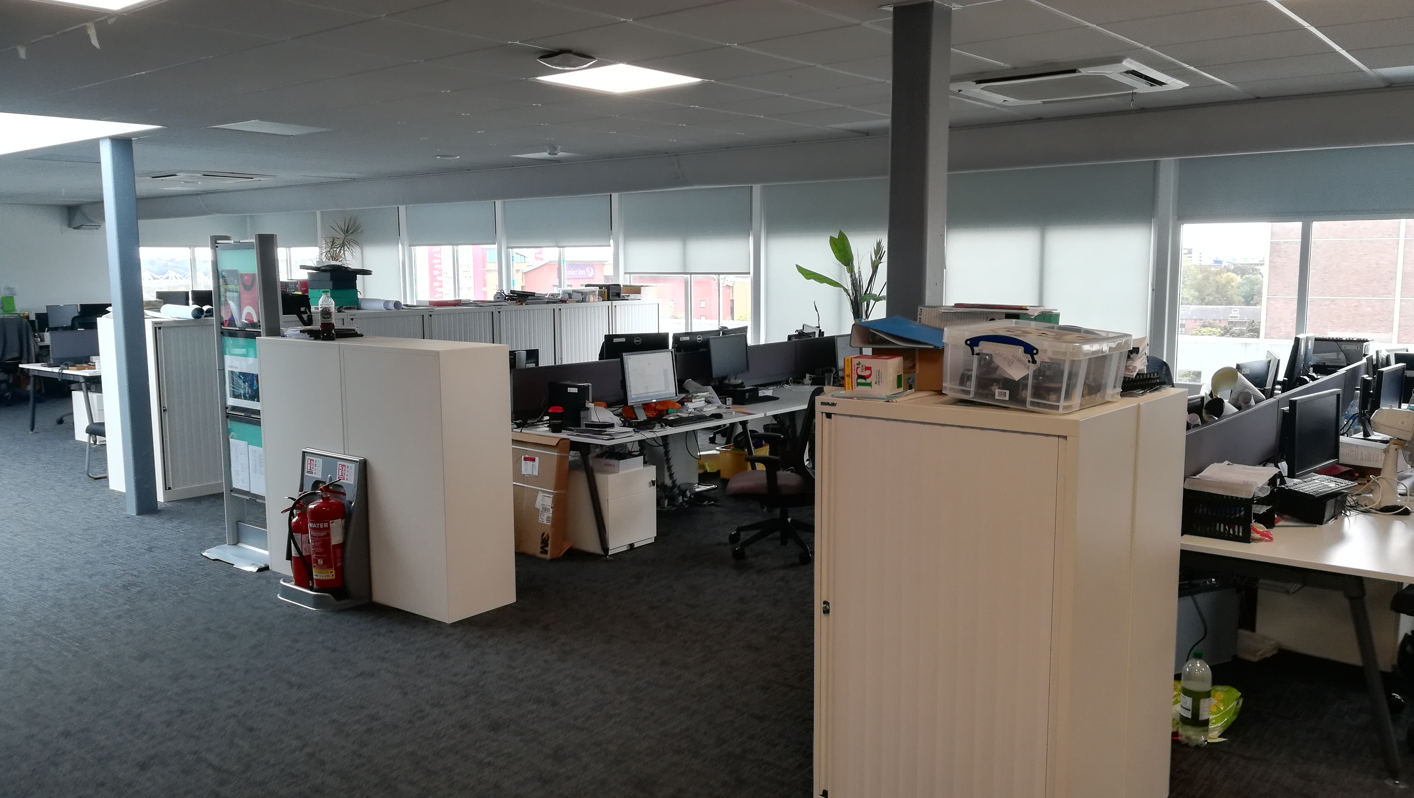

Slide 17
X
fluffybunny@hotmail.com
Use Solent student email
Full Name Student Number
Course & Level

Slide 18
Module/tutor Leader
Reviewer
Course Leader
Student Hub

Slide 19
https://martinsolent.github.io/data_level_4/

Slide 20
https://learn.solent.ac.uk/course/view.php?id=42256&section=0#tabs-tree-start

Slide 21
https://students.solent.ac.uk/student-hub

Slide 22
https://students.solent.ac.uk/student-hub/mental-health-support

Slide 23
Review meetings
Tripartite review meetings take place regularly throughout the apprenticeship and are usually held every semester.
At tripartite review meetings the apprentice, their employer, and an academic formally meet to assess progress and ensure that the apprentice is on track both in terms of their academic programme and their work-based learning. Your Reviewer doubles up as your personal tutor
https://learn.solent.ac.uk/course/view.php?id=42080&section=11#tabs-tree-start

Slide 24
TEACHING DELIVERY

Slide 25
24 Months – on-programme
3 Semesters per year Study 1 modules at a time plus 3 Months – Gateway EPA

Slide 26
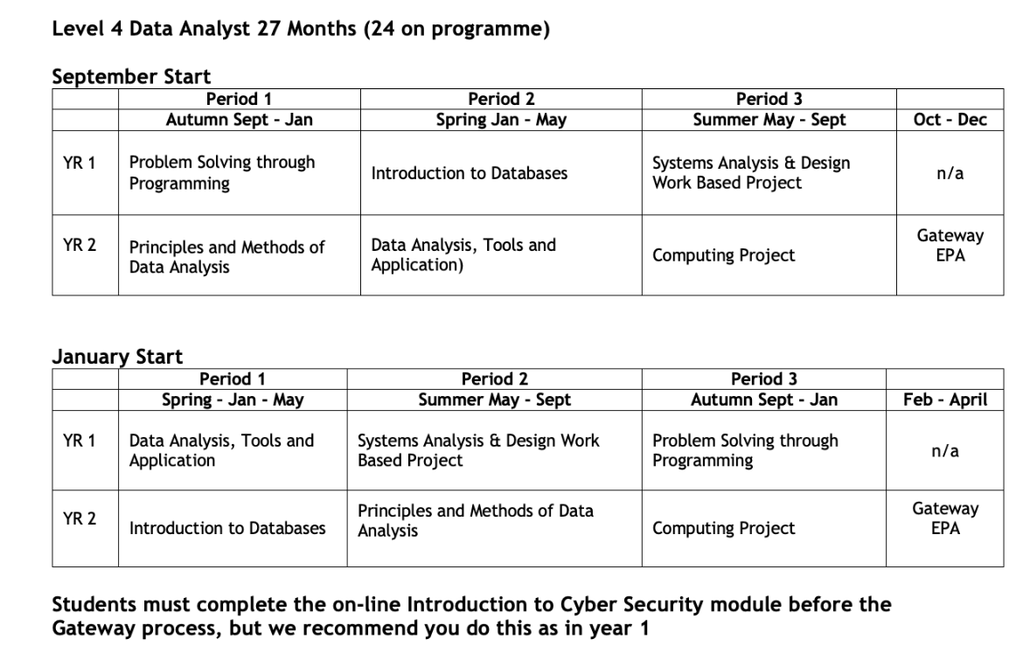

Slide 27
FACE-TO-FACE Campus Teaching Delivery
Opportunity for Hybrid learning on Summer modules (May-Sept)

Slide 28
Study Days
TUESDAYS

Slide 29
ACADEMIC CALENDAR

Slide 30
Full-time Job

Slide 31
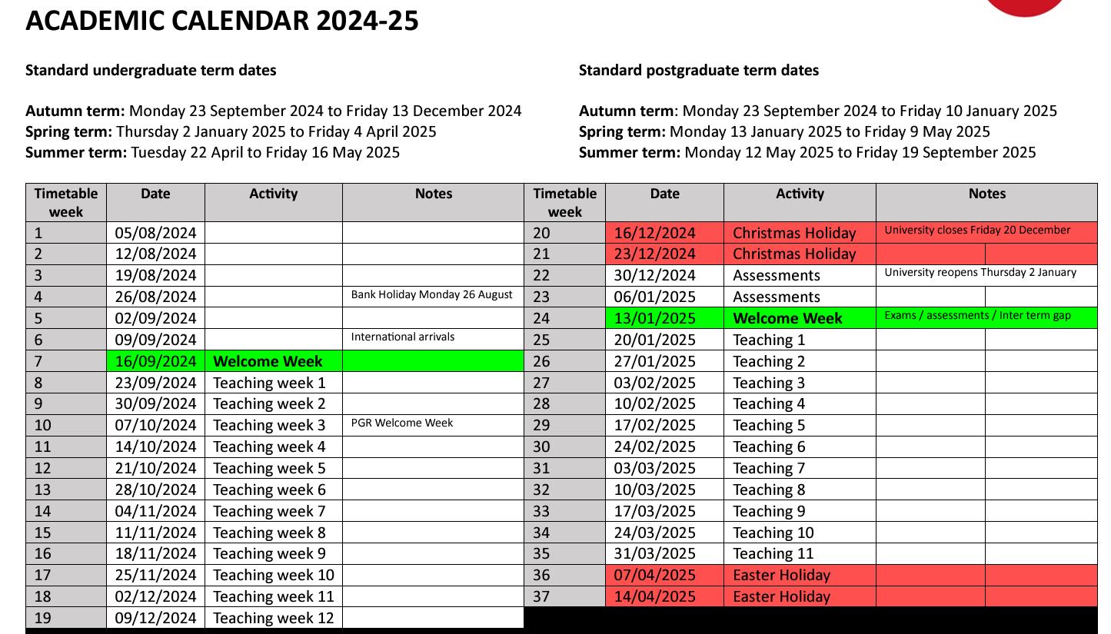

Slide 32
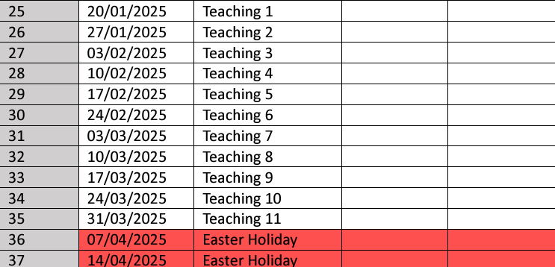

Slide 33
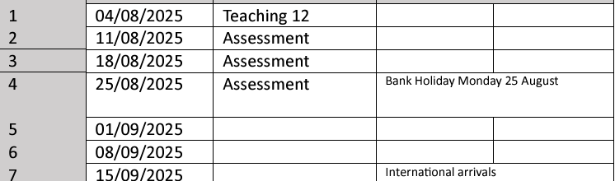
https://students.solent.ac.uk/official-documents/policy-governance-and-information/academic-calendar-2024-25.pdf

Slide 34
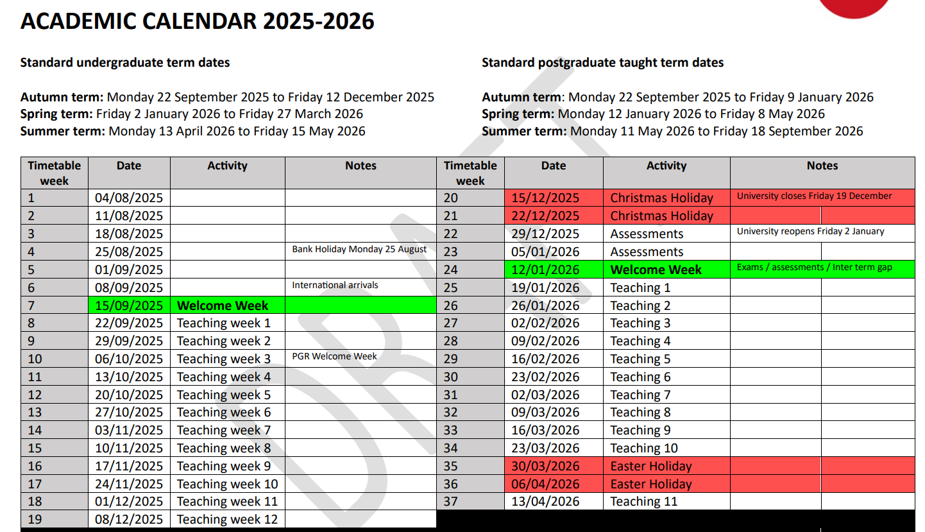

Slide 35
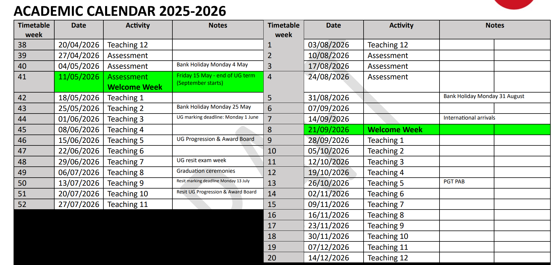
academic-calendar-2025-2026

Slide 36
Off the Job Tracker
https://learn.solent.ac.uk/course/view.php?id=42080&section=10#tabs-tree-start

Slide 37
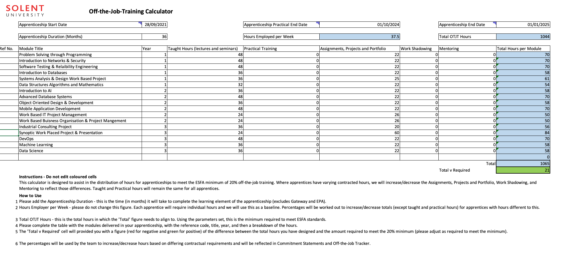

Slide 38
Calculating Off-the-job Training
When calculating the required amount of off-the-job training, the apprentice’s statutory leave entitlement must be deducted.
Employees who work a 5-day week receive 28 days paid statutory leave (20 days annual leave plus 8 Bank Holidays), which is the equivalent of 5.6 weeks of holiday.
The apprentice’s own annual leave entitlement, which may be higher than the statutory leave allowance, must not be used in the calculation.

Slide 39
Calculating Off-the-job Training
Therefore, for a full-time apprentice following a 12-month apprenticeship, off-the-job training is delivered over 46.4 weeks (52 weeks minus 5.6 weeks of statutory leave).
DEPARTMENT FOR EDUCATION, 2023. Apprenticeship off- the-job training Policy background and examples to support the 2023 / 2024 apprenticeship funding rules [viewed 2 May 2024]. Available from: https://assets.publishing.service.gov.uk/media/6530efdb92895c000ddcba2b/2023_10_OTJT_Guide_v5_-_23_24_Rules_v1.0.pdf

Slide 40
Calculating Off-the-job Training
The training provider is responsible for ensuring that there is a plan for active learning (off-the-job training to take place in every calendar month of the practical period this is to keep the apprentice engaged and working towards the achievement of their apprenticeship.
DEPARTMENT FOR EDUCATION, 2023. Apprenticeship off- the-job training Policy background and examples to support the 2023 / 2024 apprenticeship funding rules [viewed 2 May 2024]. Available from: https://assets.publishing.service.gov.uk/media/6530efdb92895c000ddcba2b/2023_10_OTJT_Guide_v5_-_23_24_Rules_v1.0.pdf

Slide 41
Calculating Off-the-job Training
We do not specify a minimum amount of active learning to take place every calendar month and active learning does not need to be face to face delivery by the training provider; it can also include, for example, mentoring by the employer, virtual classrooms, online learning or the apprentice completing assignments.
DEPARTMENT FOR EDUCATION, 2023. Apprenticeship off- the-job training Policy background and examples to support the 2023 / 2024 apprenticeship funding rules [viewed 2 May 2024]. Available from: https://assets.publishing.service.gov.uk/media/6530efdb92895c000ddcba2b/2023_10_OTJT_Guide_v5_-_23_24_Rules_v1.0.pdf

Slide 42
Apprentices should be doing 46.4 Off-the-job Study Days so there is flexibility in assessment weeks and holiday breaks to self-manage your learning outside of the formal teaching delivery to take your holidays.
Below is an overview of the of the delivery for Solent University Digital Apprentices.
Trimester 1 - (Sept – Jan)
12 Weeks Teaching Delivery plus 2 weeks Assessments = 14 weeks total Plus, Winter Break 2 weeks can be used for other Training plans tasks
Trimester 2 - (Jan - May)
12 Weeks Teaching Delivery plus 3 weeks Assessments = 15 weeks total Plus, Spring Break 2 weeks can be used for other Training plans tasks
Trimester 2 – (May – Sept)
9 Weeks Teaching Delivery plus 3 week directed Learning & 3 weeks Assessments = 15 weeks total Plus, Summer Break 3 weeks can be used for other Training plans tasks

Slide 43
SOLENT PORTAL

Slide 44
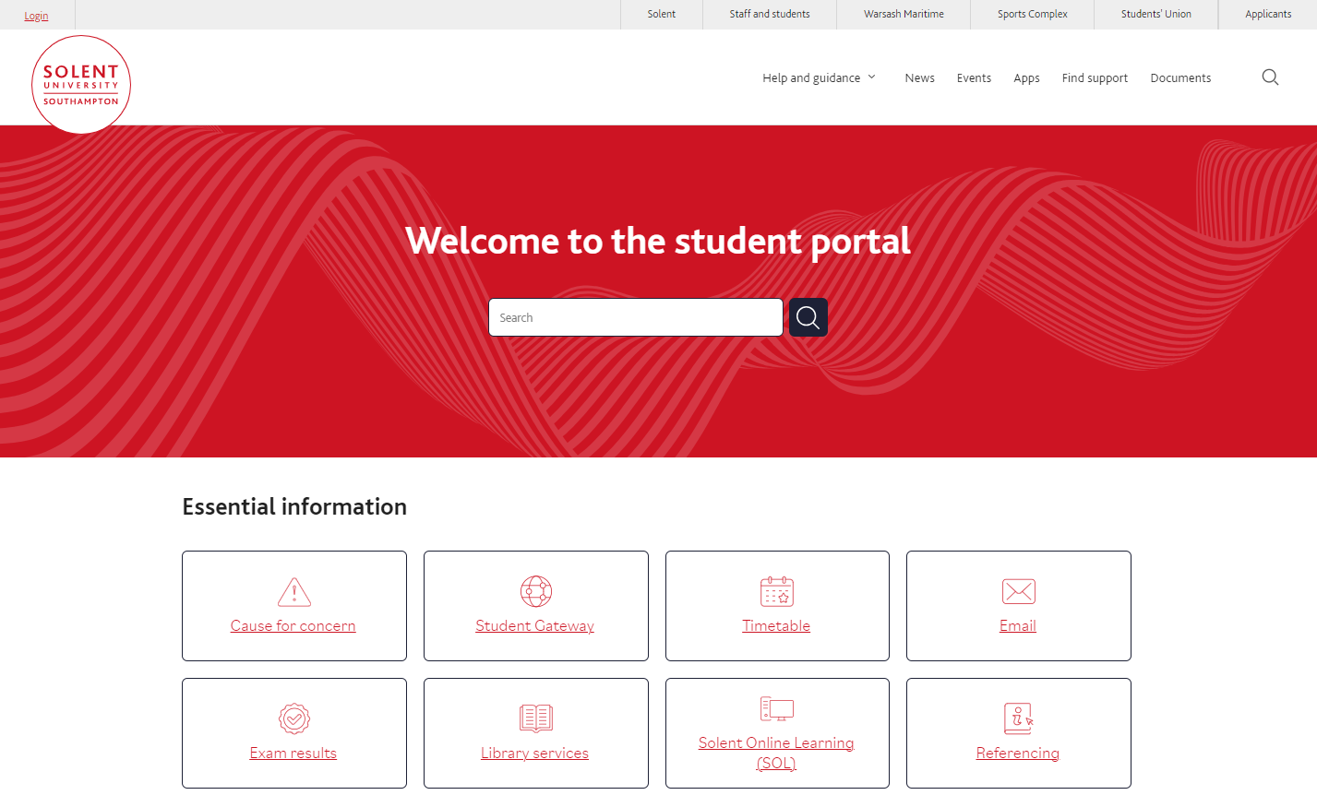
https://students.solent.ac.uk/

Slide 45
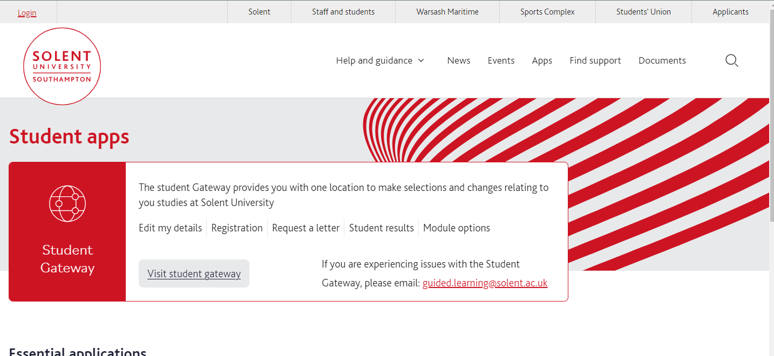

Slide 46
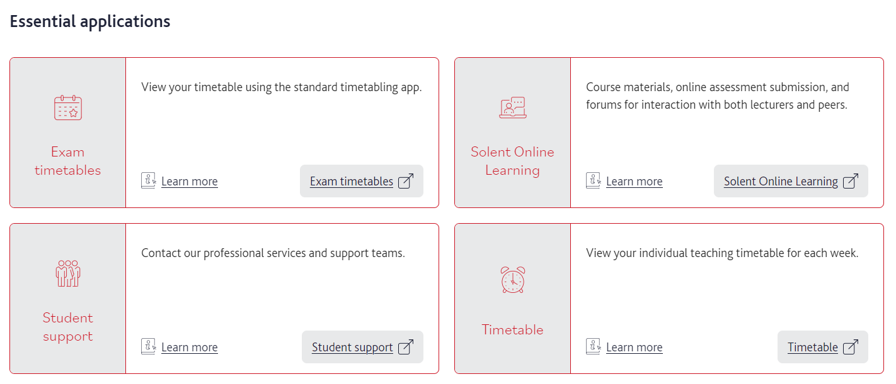

Slide 48
Timetabling & Attendance Monitoring

Slide 51
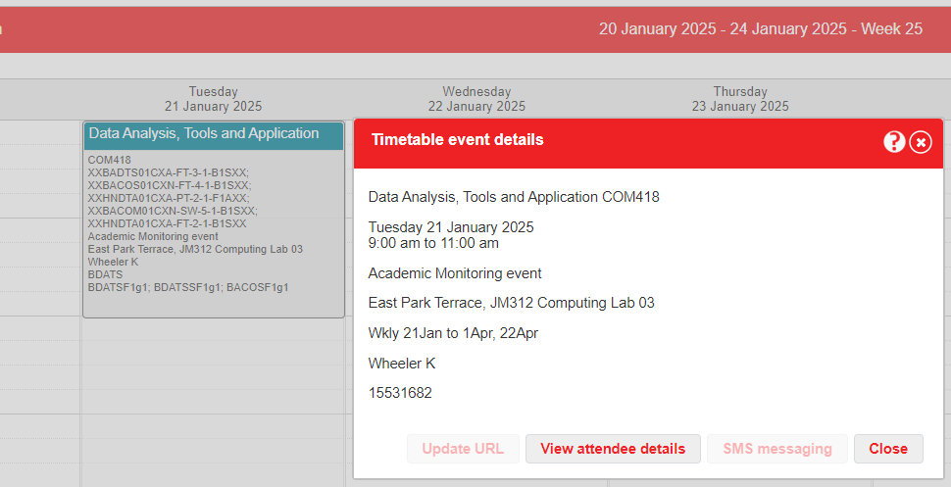

Slide 52
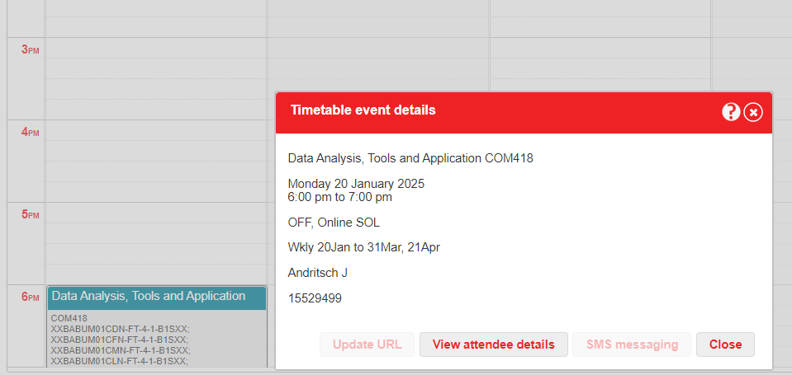

Slide 53
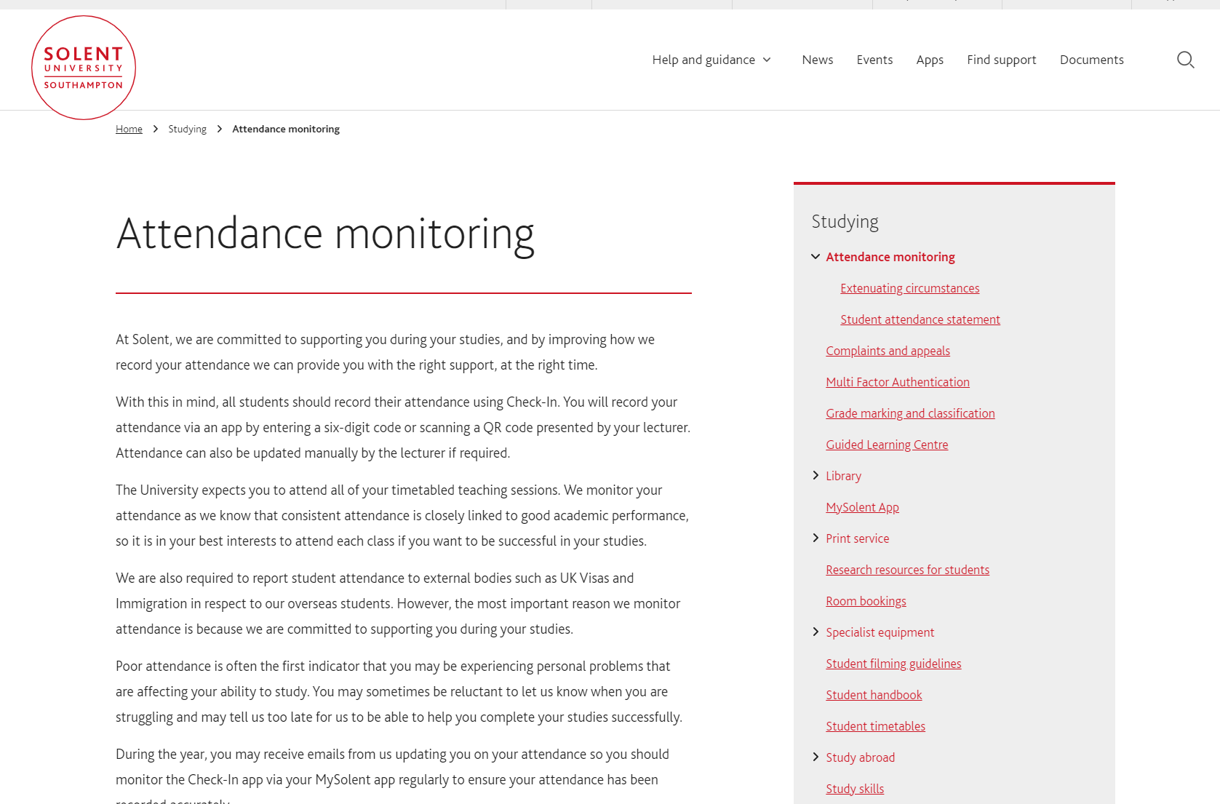
https://students.solent.ac.uk/studying/attendance-monitoring#:~:text=How%20does%20the%20University%20monitor,matches%20it%20against%20your%20timetable

Slide 55
ASSESSMENTS & GRADING

Slide 56
Grades from first year (Level 4) do not count to your final degree classification
Final module grades need to average out at 40 to pass a Module
1 compensation will be awarded per level on a marginal fail between 30-39

Slide 57
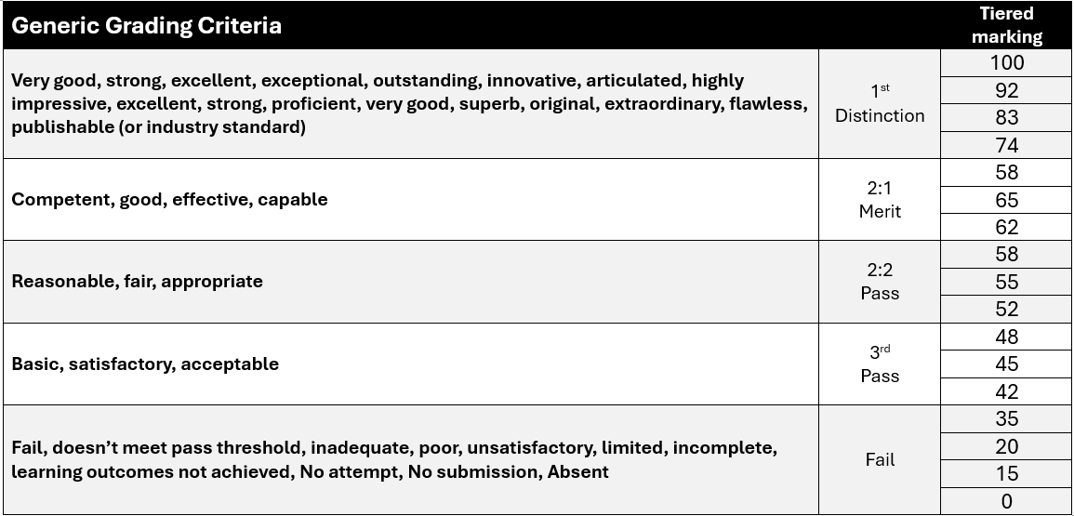

Slide 58
Refer
If you fail or don’t submit an assessment element/fail a module, you will be given a referral (a retake) which will be capped at 40%

Slide 59
Defer
If you apply for extenuating circumstances (EC) and are successful you will be given Deferral which is not capped.

Slide 60
Deferrals and referrals take place the first week in July for Under Graduates

Slide 61
EPA
Endpoint Assessment
Final 3 months of apprenticeship

Slide 62
Assessment method 1: Project with presentation and questioning
(This assessment method has two components.)
Assessment method 1 component 1: Data Analysis Project The project is compiled after the apprentice has gone through the gateway. The work-based project should be designed to ensure that the apprentice’s work meets the needs of the business, is relevant to their role and allows the relevant KSBs to be demonstrated for the EPA. The project report has a maximum word limit of 3,500.

Slide 63
Assessment method 1 component 2: Presentation with Questioning Overview Apprentices will prepare and deliver a presentation that appropriately covers the KSBs assigned to this method of assessment. The presentation with questioning will last for 40 minutes. The presentation will typically last for 20 minutes and the questions and answers will typically last for 20 minutes

Slide 64
Assessment method 2: Professional discussion with portfolio (This assessment method has 1 component.) Assessment method 2 component 1: This assessment will take the form of a professional discussion which must be appropriately structured to draw out the best of the apprentice’s competence. It will involve the questions that will focus on the KSBs mapped to this method of assessment. The professional discussion must last for 60 minutes.

Slide 65
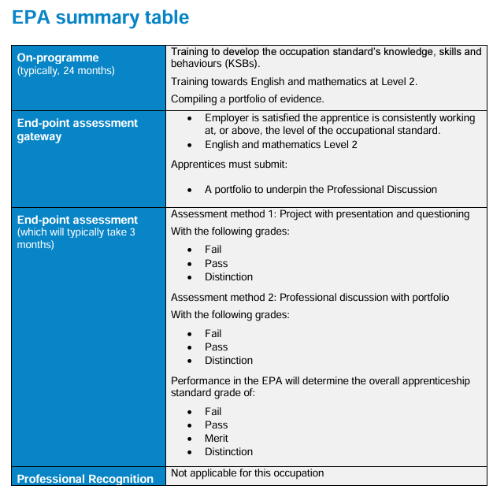

Slide 66
STUDENT COURSE REPRESENTATIVES

Slide 67
Course Reps - (run by Students’ Union)
The system for recruiting new course reps has changed for the year and will be owned by the Students’ Union We are now only recruiting one Course Rep per level, per course. This is in line with changes approved at Education Committee previously. We will also now be appointing course reps, rather than going through an election process. Academic colleagues are asked to promote the opportunity to students, ask for volunteers and then have students fill in the form here (QR code on the next slide). Deadline: 11th October

Slide 68
Course Reps - (run by Students’ Union)
If there is interest from more than one student, please ask them to fill in the form and a decision will be made by the SU how many course reps will be confirmed and who the course rep is, they will contact you to confirm the outcome (preference will be given to previous course reps). •
Training will be held w/c 14th October before the first Committees. Enhanced support package for the year for course reps. Any questions on course reps can be sent to hannah.piatkiewicz@solent.ac.uk

Slide 69
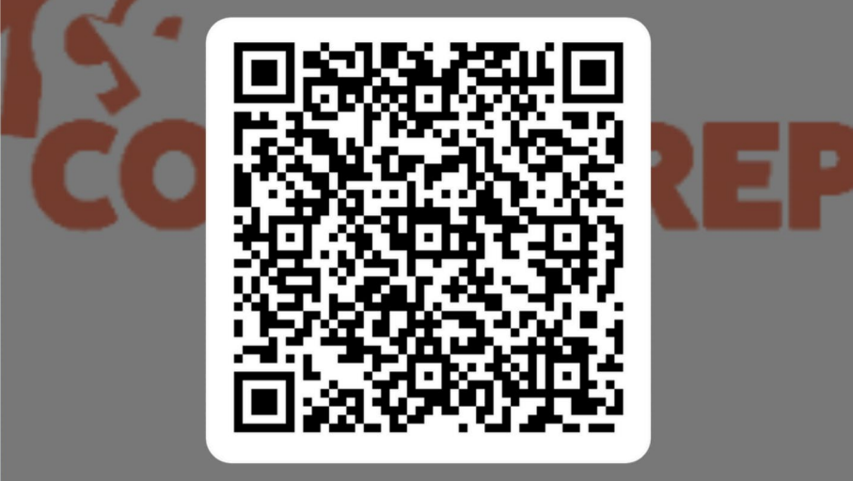
Course Rep nomination

Slide 70
Questions

Slide 71
Thank You

