Slide 1
SYNOPTIC PROJECT
Module Introduction
BSc Digital & Technology Solutions Professional (ST0119 - 2015 – version: 1.1)

Slide 2
Gateway

Slide 3
Upon completion of the on-programme off-the-job training, a Gateway meeting will be arranged to ensure that the apprentice has completed and passed all modules* and is ready to progress to the Synoptic Project/End Point Assessment (EPA).
This meeting will also verify that a Synoptic Project outline has been completed and has been agreed by both the employer and Solent
*This will be dependent on Assessment Board results

Slide 4
Link to External DATS Course Info for Employers
Link to Internal DATS Course Page on SOL

Slide 5
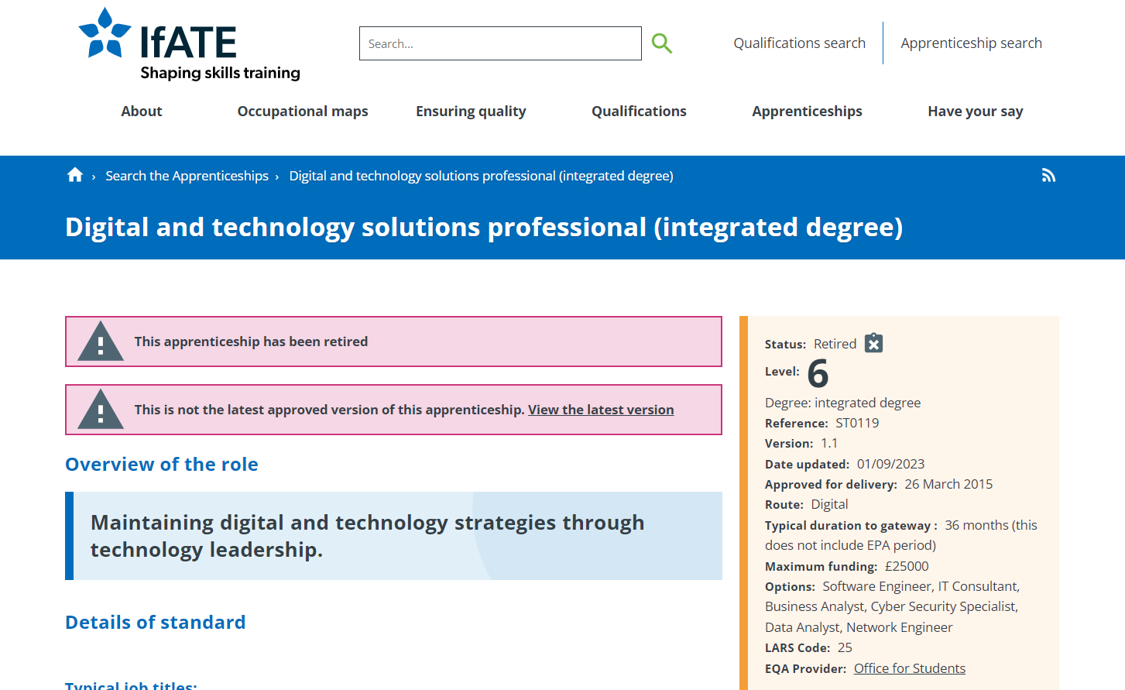
BSc Digital & Technology Solutions Professional (ST0119 - 2015 - version: 1.1)
INSTITUTE FOR APPRENTICESHIPS, 2015. Digital and technology solutions professional (integrated degree) [viewed 18 October 2024]. Available from: https://www.instituteforapprenticeships.org/apprenticeship-standards/digital-and-technology-solutions-professional-integrated-degree-v1-1

Slide 6
KSB
Knowledge, Skills & Behaviours

Slide 7
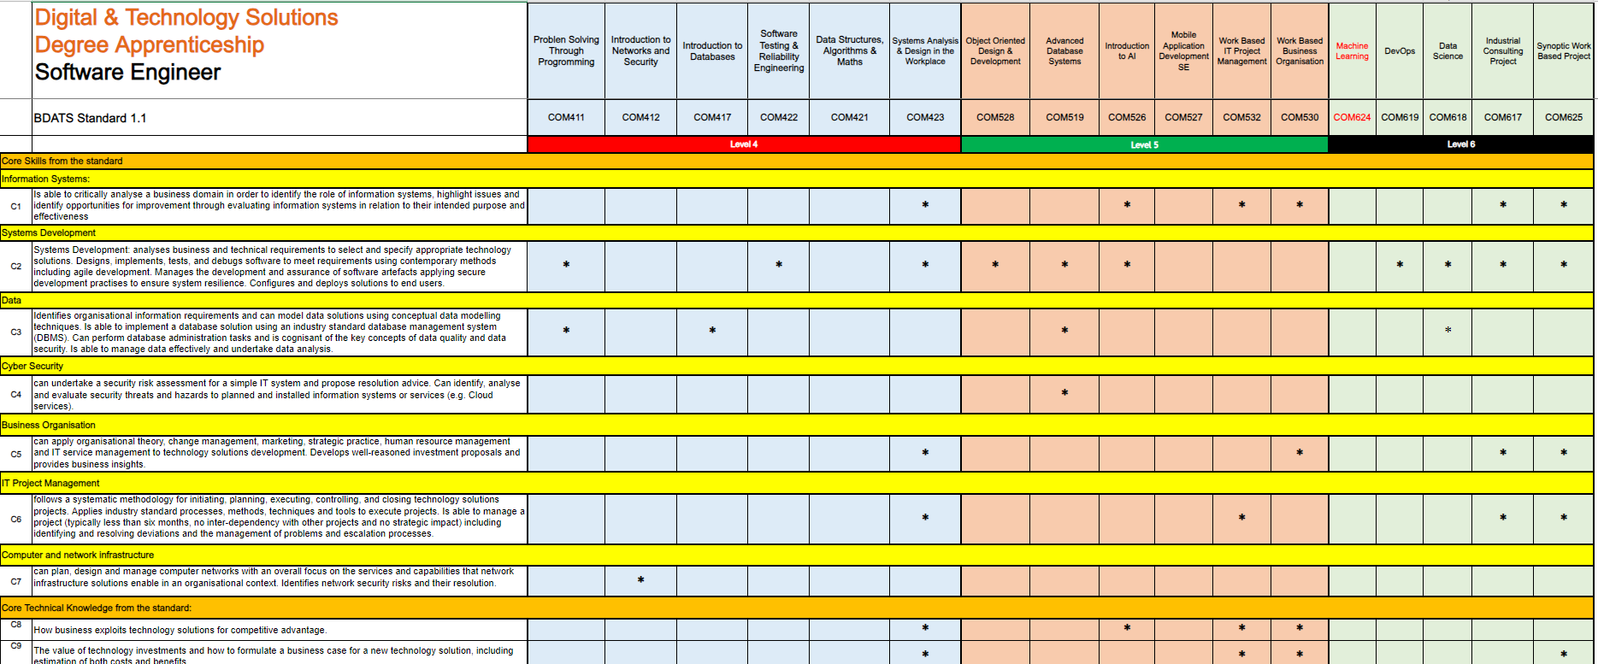
Knowledge, Skills & Behaviours (KSBs) Mapping

Slide 8
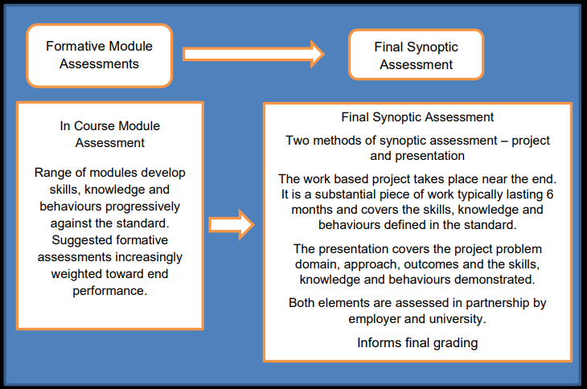
BSc Digital & Technology Solutions Professional (ST0119 - 2015 - version: 1.1)
INSTITUTE FOR APPRENTICESHIPS, 2015b. DIGITAL INDUSTRIES -ASSESSMENT PLAN DIGITAL & TECHNOLOGY SOLUTIONS PROFESSIONAL BSC (Hons) Digital & Technology Solutions. instituteforapprenticeships.org. Institute for Apprenticeships [viewed 18 October 2024]. Available from: https://www.instituteforapprenticeships.org/media/1073/digital_and_technology_solutions_professional.pdf

Slide 9
Overall Assessment Strategy
The assessment strategy for the Degree Apprenticeship includes a balanced mix of essays, reports, practical exercises, coursework, and tests. These are mapped to each module of the BSc Digital & Technology Solutions Degree Apprenticeship to assess the development of Knowledge, Skills, and Behaviours (KSBs). The End Point Assessment (EPA) consists of a Synoptic Project and Presentation.
INSTITUTE FOR APPRENTICESHIPS, 2015b. DIGITAL INDUSTRIES -ASSESSMENT PLAN DIGITAL & TECHNOLOGY SOLUTIONS PROFESSIONAL BSC (Hons) Digital & Technology Solutions. instituteforapprenticeships.org. Institute for Apprenticeships [viewed 18 October 2024]. Available from: https://www.instituteforapprenticeships.org/media/1073/digital_and_technology_solutions_professional.pdf

Slide 10
The Synoptic work-based project takes place near the end of the apprenticeship. It is a substantial piece of work and covers the skills, knowledge and behaviours defined in the standard.

Slide 11
The End Point Assessment (EPA) integrates the project outcomes and presentation into the overall Synoptic Project Assessment.
Two methods of assessment:
Synoptic Work based Project Practical & reporting
Presentation 1 hour (30mins plus Q&A) to the EPA Assessor, Tutor & Employer
INSTITUTE FOR APPRENTICESHIPS, 2015b. DIGITAL INDUSTRIES -ASSESSMENT PLAN DIGITAL & TECHNOLOGY SOLUTIONS PROFESSIONAL BSC (Hons) Digital & Technology Solutions. instituteforapprenticeships.org. Institute for Apprenticeships [viewed 18 October 2024]. Available from: https://www.instituteforapprenticeships.org/media/1073/digital_and_technology_solutions_professional.pdf

Slide 12
BSc Digital & Technology Solutions Professional (ST0119 - 2015 - version: 1.1)
On Programme Completion
Gateway EPA Ready Meeting & Sign off
Synoptic Project Outline
Gateway
Synoptic Project COM625
Completed Synoptic Project & 10 Report
Employer Reference
KSB Portfolio Mapping/Matrix
Completed Off-the-Job Tracker
End Point Assessment (EPA)

Slide 13
Synoptic Project

Slide 14
The final Synoptic Project is a substantial piece of work, typically taking around 6 months to undertake alongside the apprentices' normal duties to their employer and will include doing practical work and report writing.

Slide 15
AE1 – Report 1 - 10% (1500 words)
The initial phase of the project focuses on defining its scope and purpose, including any relevant business, ethical, legal, and professional considerations. This phase also involves reviewing existing literature and developing a project plan. Feasibility and requirements are assessed during this stage as well.
AE1

Slide 16
AE2 – Report 1 - 70%) (10,000 words)
The final project report should present a narrative of the project from inception to completion, aligned with the relevant Knowledge, Skills, and Behaviours (KSBs). It should outline the approaches taken, the rationale for their selection, and assess the project’s outputs in terms of their suitability for purpose. The report should also include conclusions, a critical review of the overall process, and recommendations for future development.
AE2

Slide 17
AE3 – Demo/Presentation - 20% (25-30mins)
To support your Project Report, you will need to give a presentation/demonstration of your project.
AE3

Slide 18
Project Selection
image: Ian Mationg

Slide 19
The Project Aim The project should add value to your organisation, and it needs to hit the pathway learning outcomes (KSBs) that are in the apprenticeship standard.
Digital and technology solutions professional (integrated degree) / Institute for Apprenticeships and Technical Education

Slide 20
Project Selection All learning throughout the apprenticeship is designed to prepare for the Synoptic Project and the subsequent EPA assessment.
Reminders and discussions about the EPA will be incorporated into work-based modules, reviews, and throughout the second year.

Slide 21
Apprentice Project Support
Someone responsible for managing the project from the employer perspective.
The university project tutor will oversee and provide support to the apprentice through the COM625 module and the EPA Period.

Slide 22
Project Sign Off The project topic must be discussed, agreed upon, and approved by the University, the Apprentice, and the company/manager before the project begins using the project outline form.
Digital and technology solutions professional (integrated degree) / Institute for Apprenticeships and Technical Education

Slide 23
Considerations

Slide 24
image: pixabay.com/images/id-1850011/

Slide 27
Any issues with confidentiality and/or security will be addressed between the university, employer and apprentice allowing for projects of business value to be undertaken using real data.
image: pixabay.com/images/id-3037639/

Slide 28
Notes:
Whatever project you choose you should know how you are going to test and evaluate

Slide 29
Reading around topic area

Slide 30
Logbook
Project “Memory”

Slide 31
Project Library
Project “scrapbook”

Slide 32
Report Writing & Referencing

Slide 33
Project Outline
A Project Outline needs to be completed and sign of by Southampton Solent University, the Apprentice and their employer - it's not graded, but will give us an idea of what we intend to do for your project. A template will be supplied and once completed should be no more than one side of A4.

Slide 34
Research

Slide 35
Methods & Evaluation

Slide 36
Ethical ,Professional, Legal & Ethical issues

Slide 37
Design & Implementation

Slide 39
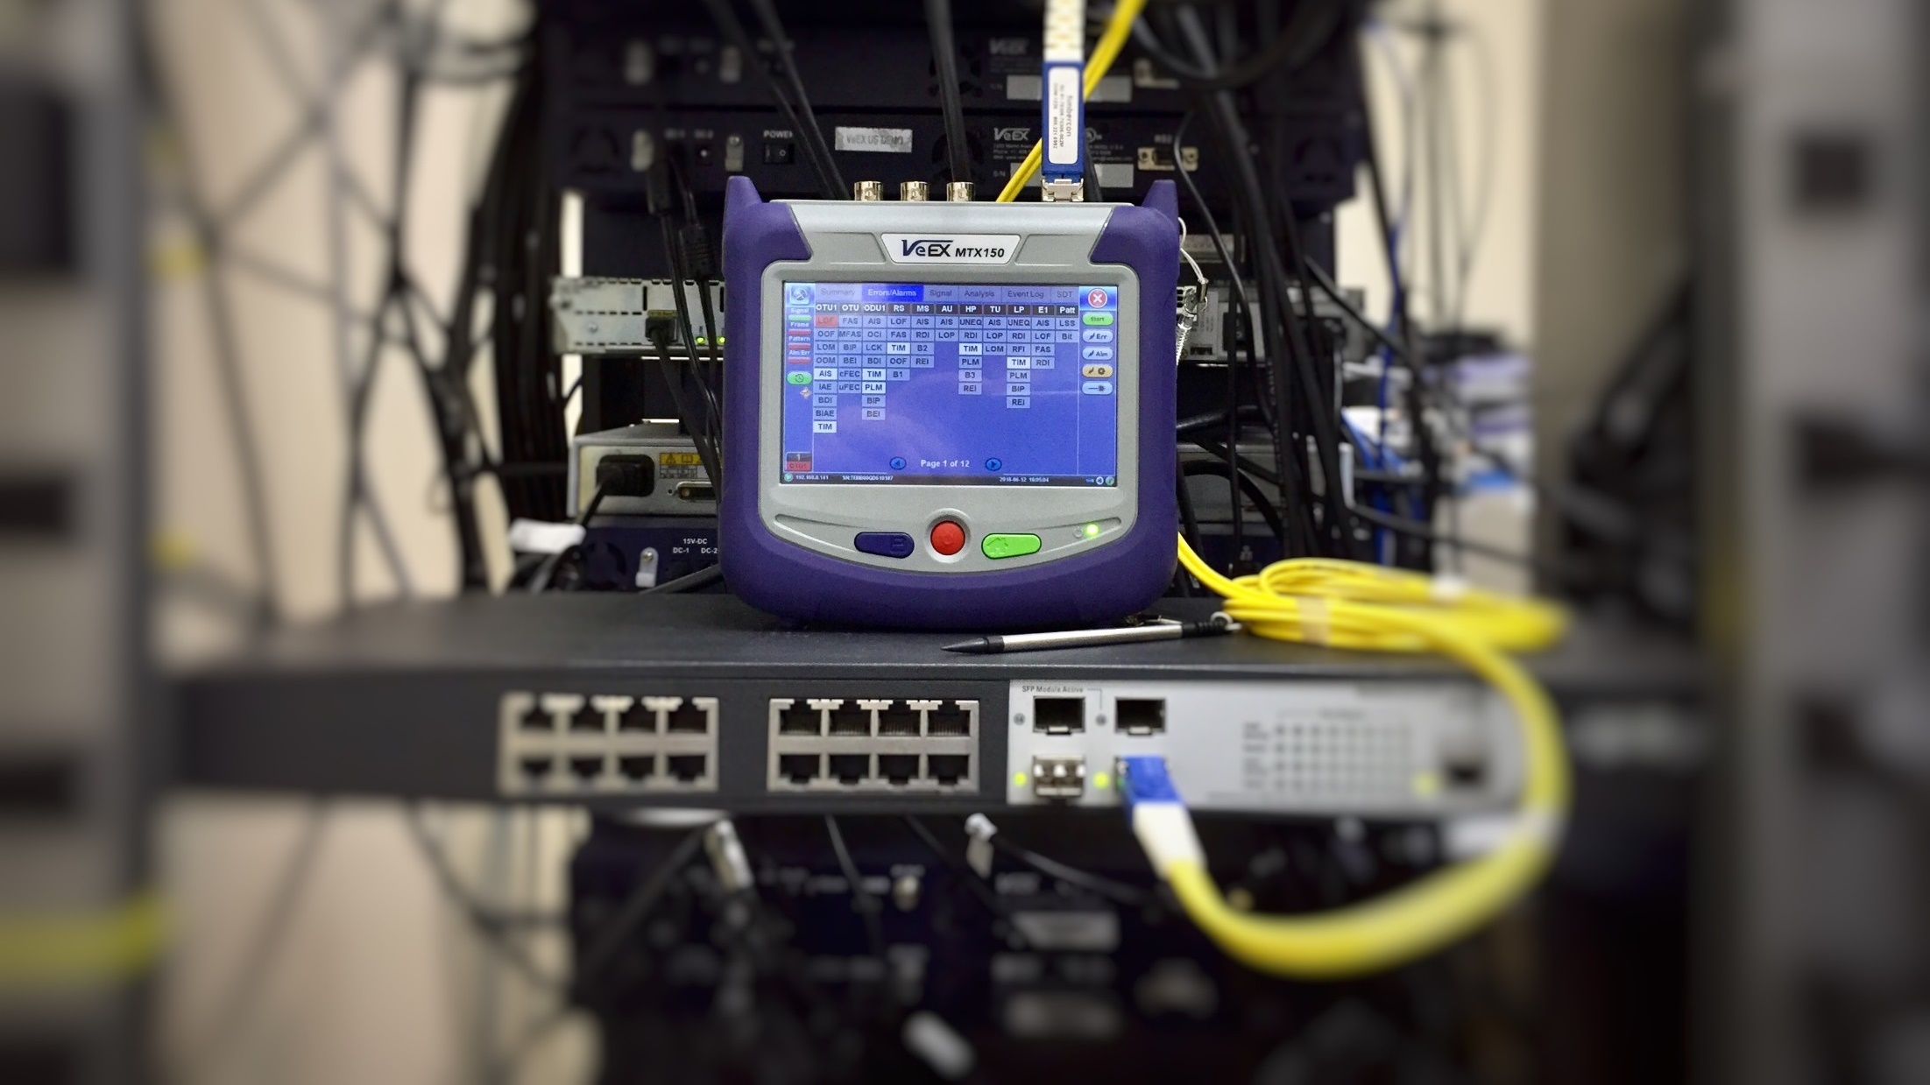
Testing

Slide 40
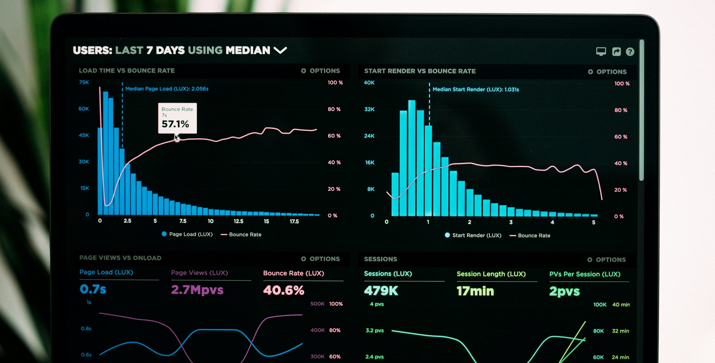
Results

Slide 41
Reporting – Final Write-up

Slide 42
Final Report Structure
Title Page
Acknowledgements
Summary
Contents
List of Figures
Project Specification/Requirements
Methodology/Evaluation
Professional, Legal and Ethical issues
Project Management
Design, implementation
Testing & Results
Conclusions
Recommendations for further Work and/or discussion
References List
Appendices

Slide 43
Employer Reference The assessment of the Synoptic Project should include the employer’s evaluation against the common criteria. This will be documented in the Employer's Reference, completed and signed on completion of the Project Report and presented in an appendix.

Slide 44
Portfolio Mapping

Slide 45
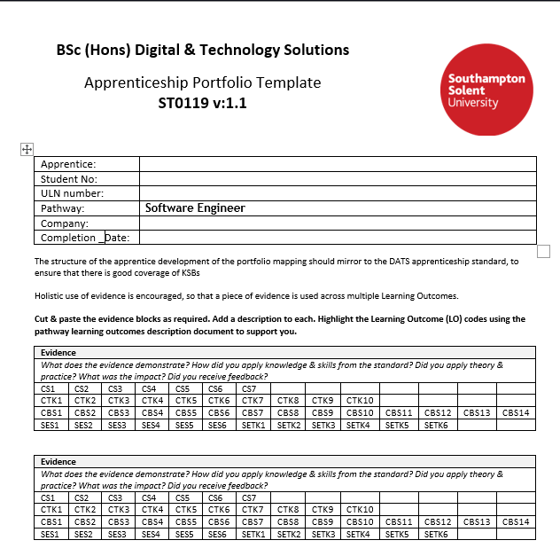

Slide 46
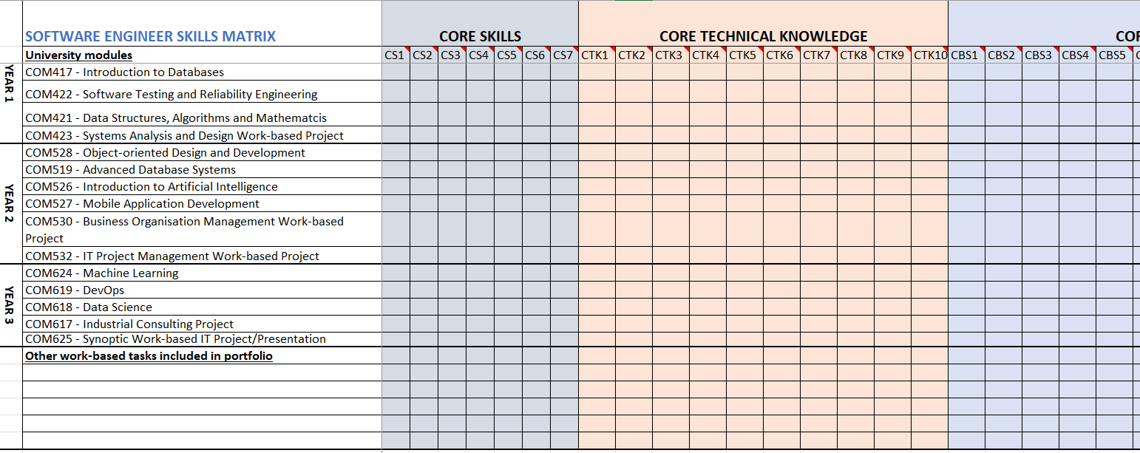

Slide 47
EPA
End Point Assessment

Slide 48
EPA Presentation - 1 hour

Slide 49
"The presentation is a structured discussion between the apprentice and their university lecturer/s and employer, focusing on the outcomes of the synoptic project. It covers both what the apprentice has done, the standard of their work, and how they have done it."
The Presentation (P.7 2.2.3)
INSTITUTE FOR APPRENTICESHIPS.ORG, 2015. DIGITAL INDUSTRIES -ASSESSMENT PLAN DIGITAL & TECHNOLOGY SOLUTIONS PROFESSIONAL BSC (Hons) Digital & Technology Solutions [viewed 14 February 2025]. Available from: https://www.instituteforapprenticeships.org/media/1073/digital_and_technology_solutions_professional.pdf

Slide 50
The EPA Presentation serves to demonstrate how the apprentice has approached and achieved the project. It aims to explore the apprentices' process including problem solving and overall work, and must:
Review the project's aims and results.
Demonstrate the standard of work.
Explain the approach and address issues.
Clarify any questions from university/employer/assessor.
Confirm interpersonal and behavioural skills.
Be assessed as part of the overall project assessment and inform the degree award.

Slide 51
Project Presentation
Can be conducted face-to-face or online (Photo ID required)
A conflict-of-interest form must be completed to confirm that the Apprentice and Assessor do not know each other
The Apprentice will present for 25-30 minutes, followed by a Q&A session within a 1-hour time slot
EPA Presentation - 1 hour

Slide 52
Assessment & Grading

Slide 53
Assessment and Grading
The Honours degree award and classification is based on a weighted average mark of the assessed work the apprentice has completed. The Synoptic Project (40 credits) contributes greatly to the final year marks. Apprentices will be graded using Honours degree classifications for English universities. The national degree award outcomes are shown below with apprenticeship grading equivalence. These typically are as follows:

Slide 54
Thank you

