Slide 1
REFERENCING & REPORTING
martin.reid@solent.ac.uk
  Computing | Science and Engineering Department | Solent University

Slide 2
Students
X
The idiots guide to Citation, Referencing & Report Writing

Slide 3
Research
Notes:
Before you can reference you will need to research

Slide 4
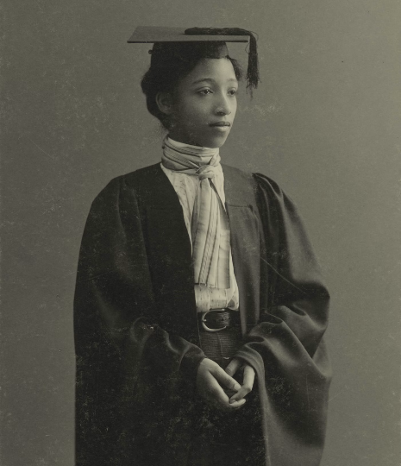
Academic Integrity
The concept of academic integrity can be traced back to the origins of formal education and scholarly pursuits.
Academic integrity refers to the ethical principles and values that underpin the pursuit of knowledge, learning, and research within an academic environment.
It is a set of standards, behaviours, and responsibilities expected from students, researchers, scholars, and educators to maintain honesty, fairness, and trustworthiness in their work.
HOLLIS HARVARD UNIVERSITY, 1898. Portrait of Alberta Virginia Scott, ca. 1898. [digital image] [viewed 28 June 2023]. Available from: http://id.lib.harvard.edu/via/olvwork347432/catalog

Slide 5
Academic Integrity
Honesty: Present work, ideas, and findings truthfully and accurately, giving proper credit to the original sources. This includes citing and referencing the works of others appropriately to avoid plagiarism.
Originality: Produce original work rather than submitting or presenting someone else's work as their own.
Attribution: Acknowledging and properly attributing the work, ideas, or intellectual property of others to avoid plagiarism.
Collaboration: Collaborative projects should involve active participation, shared responsibility, and a clear distinction between individual and group contributions.
Respect for academic community: This involves adhering to academic policies and guidelines, treating others with fairness and respect, and not engaging in dishonest practices that may compromise the integrity of the academic environment.
HOLLIS HARVARD UNIVERSITY, 1898. Portrait of Alberta Virginia Scott, ca. 1898. [digital image] [viewed 28 June 2023]. Available from: http://id.lib.harvard.edu/via/olvwork347432/catalog

Slide 6

Notes:
And avoid passing off other peoples work as your own as this would be described as plagiarism

Slide 7
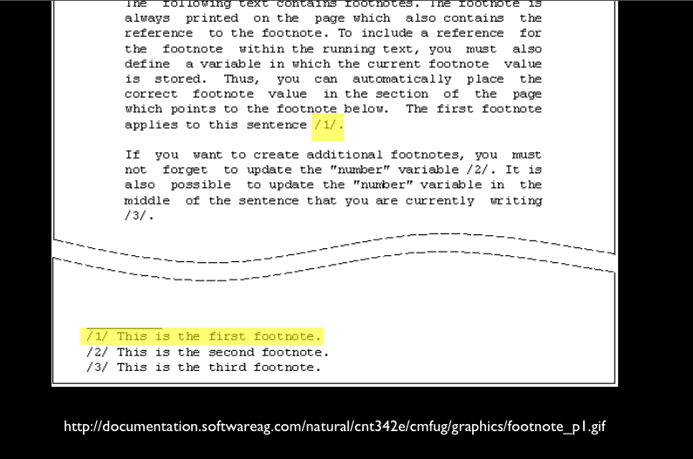
Notes:
There are a number of types of referencing systems such as footnote system

Slide 8
The in-text citation:
(Airey 2010)
Corresponding reference list item:
AIREY, D., 2010. Logo Design Love: A guide to Creating Iconic Brand Identities. Berkeley CA: New Riders.
Notes:
Example of Author date system
Author details (surname first) – use a corporate author/organisation if no individual is named
Year the material was published/created
Title details
Publication details – where and by whom a document was published (not always given for electronic material)

Slide 9

SU Harvard
Reference System
Notes:
Here at Solent we use the author date Harvard referencing system

Slide 10
(Airey 2010 p.10)
Notes:
InTEXT reference: second name date and page number in brackets

Slide 11
(Airey 2010 p.10)

Slide 12
(Airey 2010 p.10)

Slide 13
(Airey 2010)

Slide 14
Airey, D., 2010 Logo Design
Love: A guide to Creating Iconic Brand Identities.
Berkeley CA: New Riders.
Notes:
The corresponding reference list item

Slide 15
Reference List
ALL sources used in
the Report or Essay
Notes:
Reference list contains all the sources you have reference

Slide 16
Bibliography List
Sources used within
research, but not directly
referenced to.
Notes:
Reference list contains all the sources you have reference

Slide 17
In-text reference
for a book with one author
(Stevens 1996)
Reference list item:
STEVENS, M., 1996 Presentation Skills.
London: Kogan Page

Slide 18
In-text reference
for a book two authors:
(Stevens and Hatcher 1996)
Reference list item:
STEVENS, M. and C. HATCHER 1996
Presentation Skills. London: Kogan Page

Slide 19
In-text reference
for a book with three author:
(Stevens, Smith and Hatcher 1996)
Reference list item:
STEVENS, M., A. SMITH and C. HATHER 1996
Presentation Skills. London: Kogan Page

Slide 20
In-text reference
for a book three plus authors:
(Stevens et la 1996)
Reference list item:
STEVENS, M. et la 1996
Presentation Skills. London: Kogan Page

Slide 21
Secondary Sources
Shuell (cited in Biggs and Tang 2011, p.97)
Or
(Shuell cited in Biggs and Tang 2011, p.97)

Slide 22
Website:
(Stevens 1996)
Reference list item:
STEVENS, N., 1996. Presentation Skills [viewed 12 May 2016] Available from http://stevens.com/presentation-skills

Slide 23
Example of a journal entry:
  KRUGER, JUSTIN & DUNNING, DAVID, 1999. Unskilled and Unaware of It: How Difficulties in Recognizing One's Own Incompetence Lead to Inflated Self-Assessments. (Statistical Data Included). Journal of Personality and Social Psychology, 77(6), pp.1121–34.
It is a good idea to add (manually) the Digital Object Identifier: DOI to the bottom of the journal reference like this:
  KRUGER, JUSTIN & DUNNING, DAVID, 1999. Unskilled and Unaware of It: How Difficulties in Recognizing One's Own Incompetence Lead to Inflated Self-Assessments. (Statistical Data Included). Journal of Personality and Social Psychology, 77(6), pp.1121–34.
  http://dx.doi.org/10.1037/0022-3514.77.6.1121

Slide 24
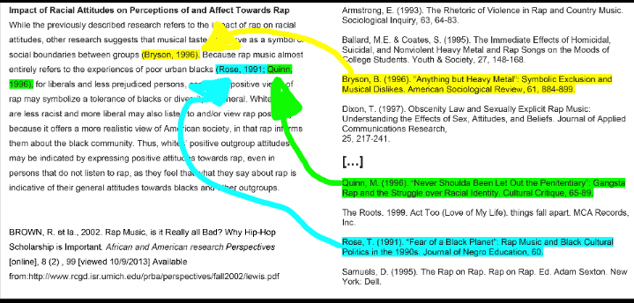
Notes:
Here is an example of InTEXT reference and and their corresponding reference list items. NOTE: Althought this example is Harvard referencing it does not use the exact same style of formatting we use here at Solent

Slide 25
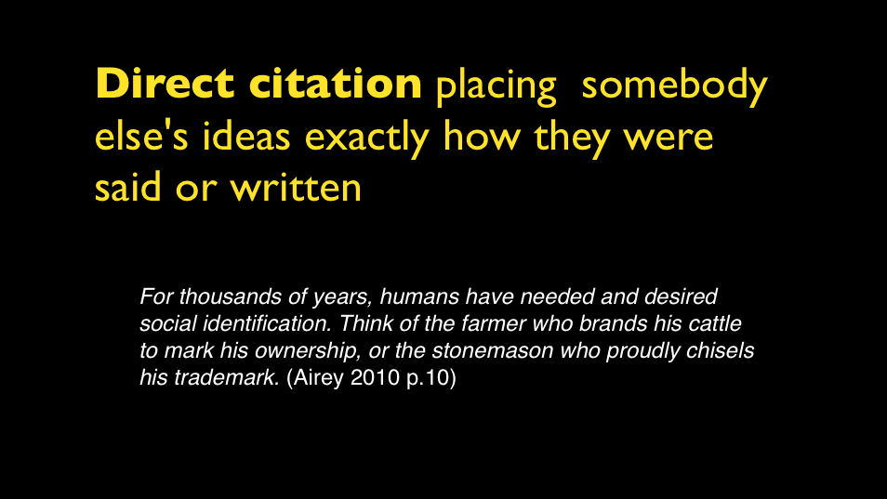

Slide 26
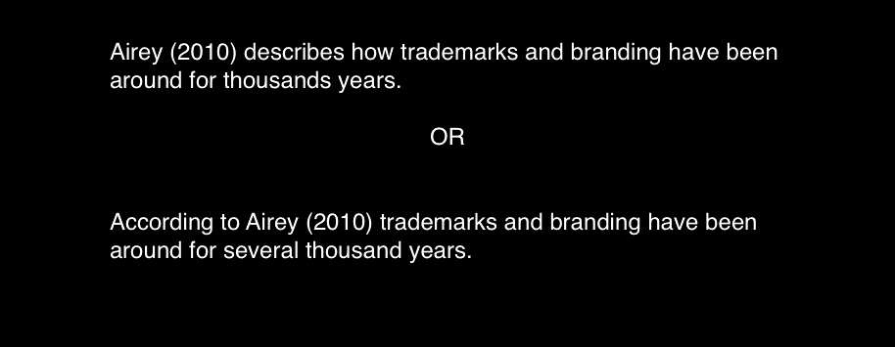

Slide 27
(Airey 2010a)
(Airey 2010b)
(Airey 2010c)
Notes:
If you have the same author but reference a number of their books add a, b, c etc

Slide 28
(Anon n.d)
Anonymous (author)
and No Date (unknown date)

Slide 29
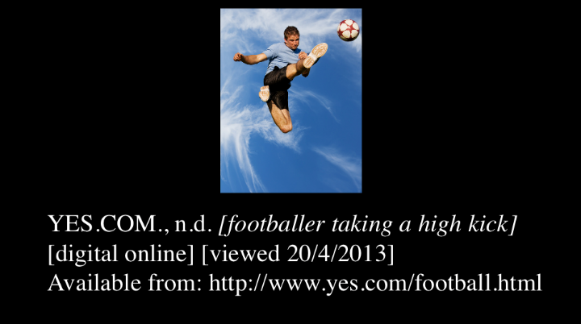
Notes:
If you have an image but do not have author or title describe the image and use the website as the author/ originator

Slide 30
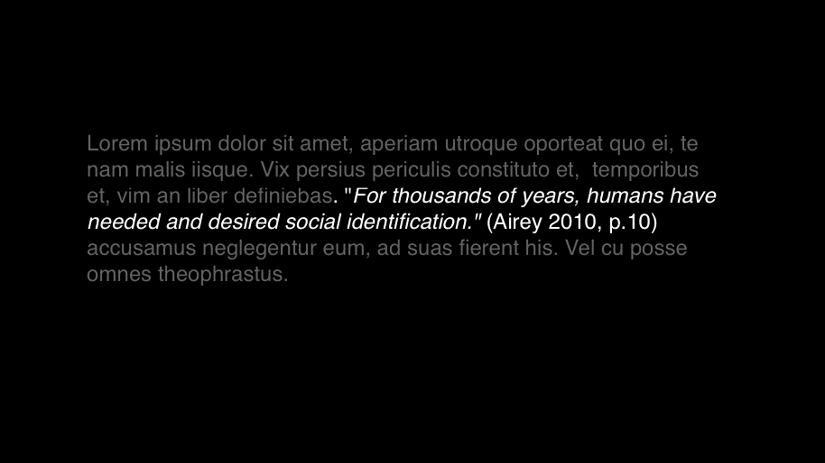
Notes:
Place short citations within the body of text

Slide 31
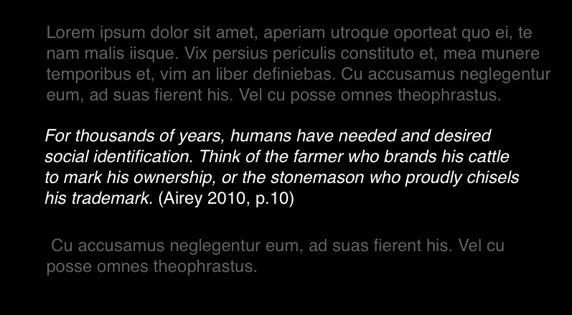
Notes:
Longer quotations as separate paragraphs make sure these are single line spacing you could place these in italics

Slide 32
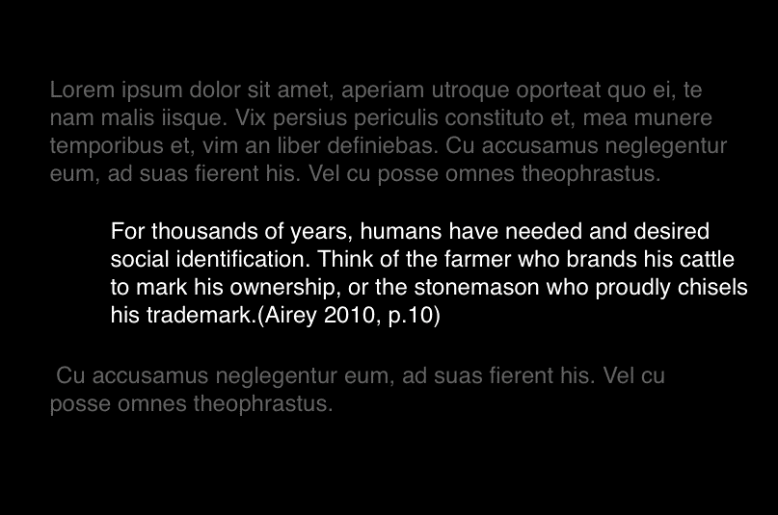
Notes:
Or you can indent

Slide 33
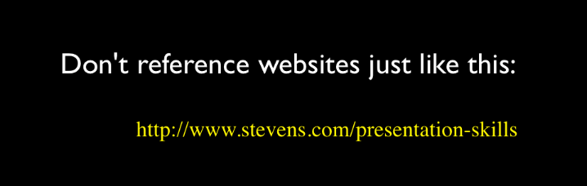
What to avoid

Slide 34
Useful abbreviations
Anon. anonymous
ed(s). editor(s) or edition
et al. and others (multiple authors)
n.d. date unknown
p. page
pp. pages
ibid. in the same book or article
op. cit. in the work already quoted

Slide 35
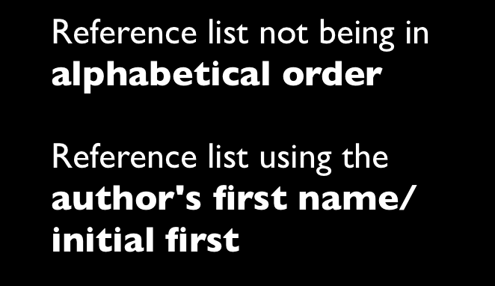
Common Mistakes

Slide 36

Notes:
But it can make

Slide 37

Notes:
or break an assignment

Slide 38
Academic Writing

Slide 39
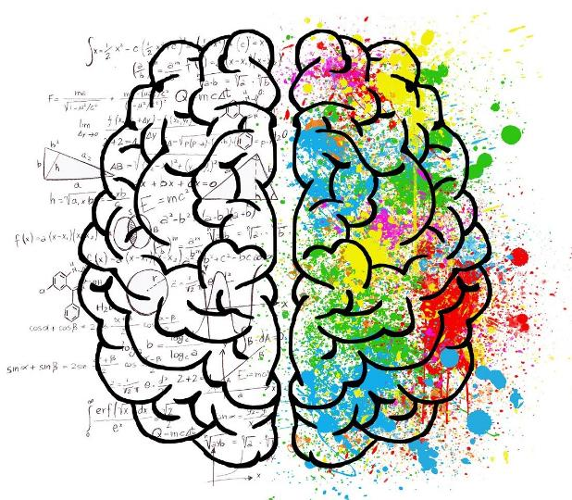
Critical Thinking

Slide 40
“Comic Sans is the best
font in the world”
(Uncool 2013 p.50)
Notes:
Look at some ideas

Slide 41
“Comic Sans sucks”
(Cool 1998 p.51)
Notes:
Then look at other ideas they might challenge or conflict. - Balance the pros & cons

Slide 42
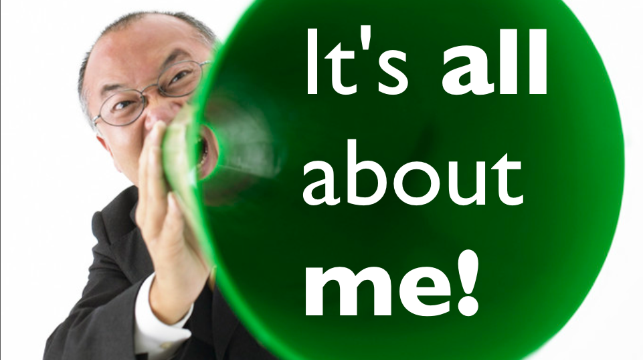
Notes:
Words to use when presenting other peoples ideas

Slide 43
Suggests…
Argues…
States…
Believes…
Concludes…
Proposes…
Expresses….
Holds the view that…
Draws attention to…
Describes…
Describes how…
Refers to…
Draws attention to…
Describes…
Describes how…
Refers to…
Takes the stand that…
Emphasises…
Stresses…
There is a view…
There is a theory…
There is an argument…
There is an idea…

Slide 44

Counter Arguments
Notes:
Words to use to set out counterarguments

Slide 45
…Conflicts…
…Contrasts…
… Not accepted by…
..has been challenged by…
…on the other hand
however…
…an alternative view is…
…suggest the opposite…
…conflicting view is
expressed by…

Slide 46
This conflicts with the view of Smith (2010) that…
Notes:
This is how it could look in the flow of your report,

Slide 47

I said this…
I said that…
I think my project is really good…
Notes:
Avoid using “I”

Slide 48
When writing a academic
Report/Essay avoid using “I”
(Talking about yourself in first person)
The are exceptions, such as when writing
about personal reflection and development

Slide 49
I will gather literature surrounding social distancing guidelines themselves and why the distance is considered safe so that I can determine a safe accuracy target. I will also need to gather literature around human depth perception and how accurately an average person can perceive depth. My app would need to be more accurate than our natural perception to be considered successful otherwise it wouldn’t be very useful. I will also need to find some papers on algorithms I intend to use such as triangle similarity to estimate the depth. I will mostly use google scholar to find sources on the topics mentioned so far. Alongside this I will be referencing Documentation from the libraries and frameworks that I will be using such as OpenCV.js, A-Frame.js, and Three.js.
I will gather literature surrounding social distancing guidelines themselves and why the distance is considered safe so that I can determine a safe accuracy target. I will also need to gather literature around human depth perception and how accurately an average person can perceive depth. My app would need to be more accurate than our natural perception to be considered successful otherwise it wouldn’t be very useful. I will also need to find some papers on algorithms I intend to use such as triangle similarity to estimate the depth. I will mostly use google scholar to find sources on the topics mentioned so far. Alongside this I will be referencing Documentation from the libraries and frameworks that I will be using such as OpenCV.js, A-Frame.js, and Three.js.

Slide 50
The research…
The design…
The project…
The approach…

Slide 51

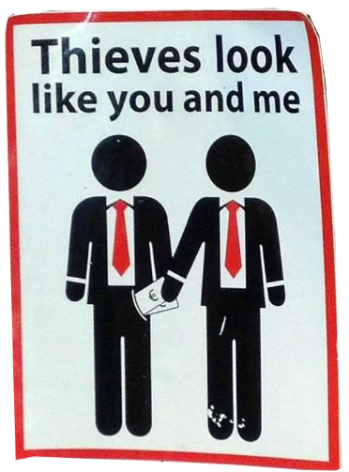

Slide 52
PLAGIARISM

Slide 53

images: Rugby471 CC BY-SA 3.0

Slide 54
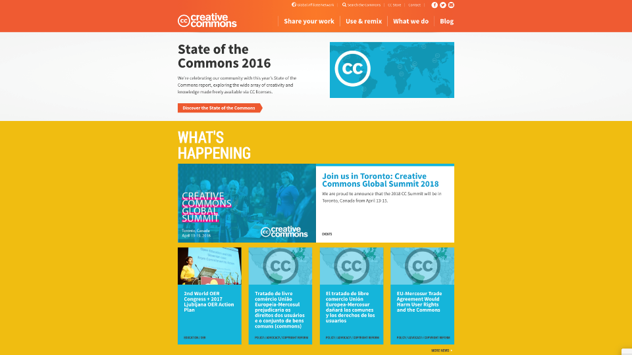
CREATIVECOMMONS. 2017. When we share, everyone wins [viewed Oct 8, 2017]. Available from: https://creativecommons.org/
Notes:
Make sure any images you use you have permission to use that image if it's just for decoration make sure you are using Creative Commons 0 or public domain images. In academic work you can use for use within copyright law to show examples of other people's work but make sure you properly site and reference to the author whatever it might be/or and owner

Slide 55
The Block Quote
Either use sparingly or avoid using at all

Slide 56
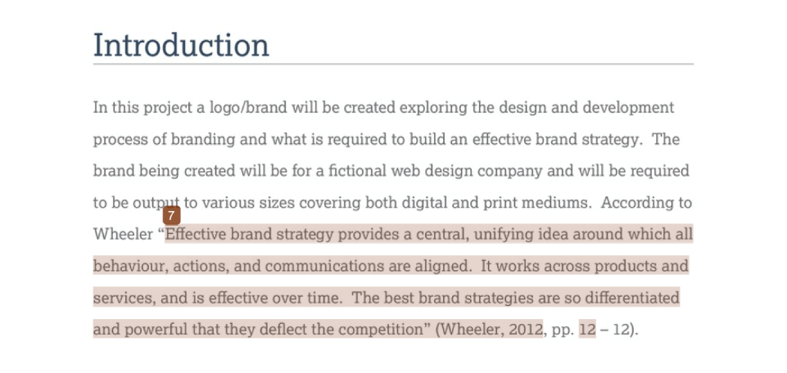

Slide 57
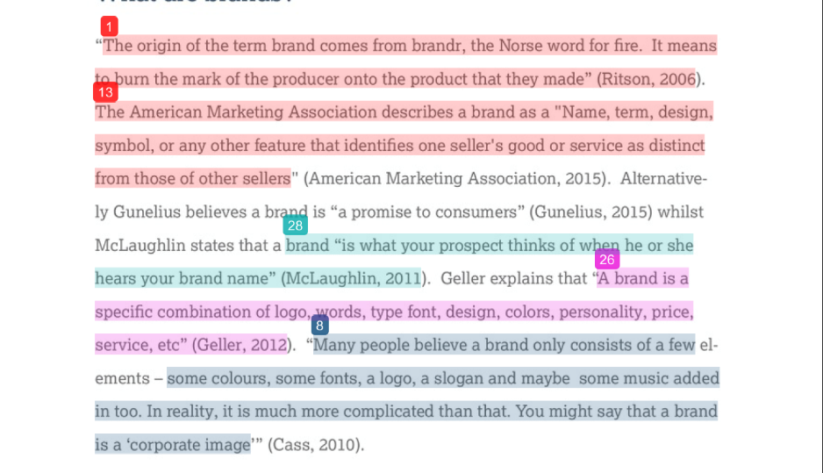

Slide 58
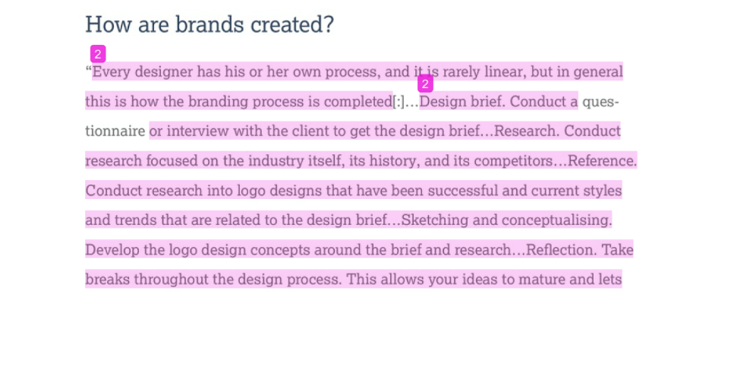

Slide 59
Paraphrasing

Slide 60
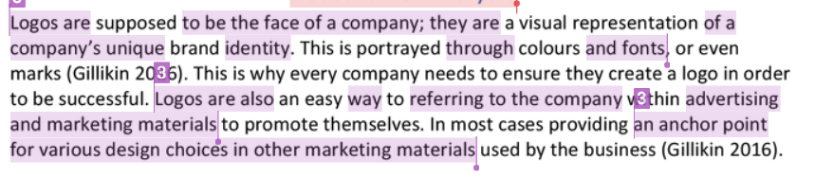
Paraphrasing is were the original work has been rearranged into a new pattern. In this example, it at first appears that the writing is all the student's “own” words, they even acknowledge the source, but there are no quotation marks.
The purple underlines show confusion between the student’s works and that of the original author.

Slide 61
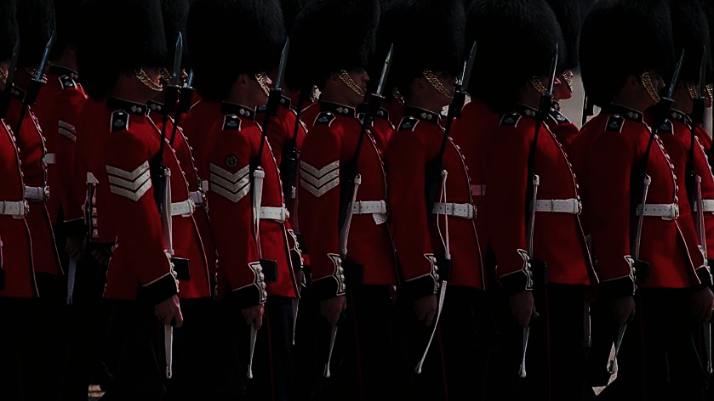
Keep your report
structure uniformed
Notes:
No matter what style you may use for referencing and academic writing make sure you keep it uniformed and consistent throughout your reports

Slide 62
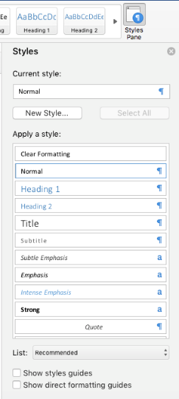
Make good use of word processing style sheets
Notes:
Make good use of word processing style sheets for titles subtitles quotes and citations and body text

Slide 63
Sign up

Slide 64

http://libguides.solent.ac.uk/refworks
Notes:
Use tools such as Refworks.com to support you

Slide 65
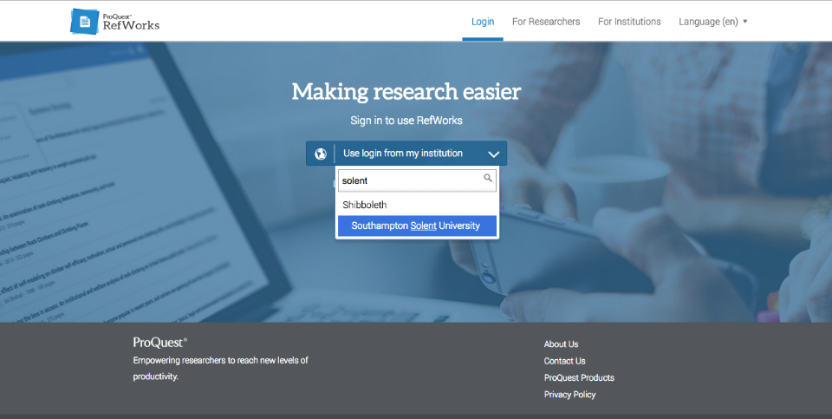

Slide 66
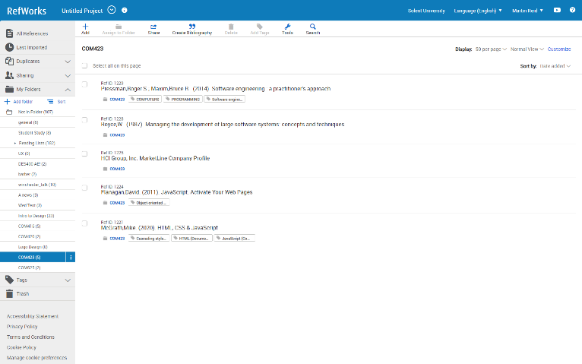

Slide 67
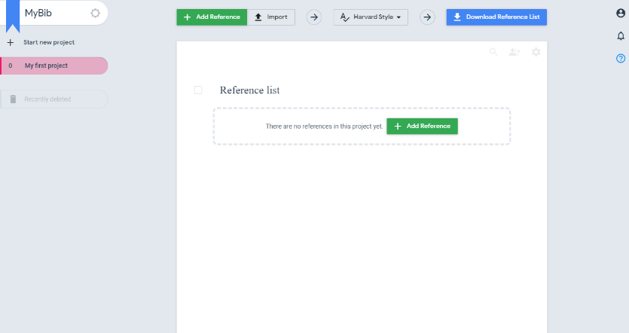
mybib.com

Slide 68
  For more detail see:
  Referencing: the Harvard way
  Available in print from the Mountbatten Library or on the portal:
  http://portal.solent.ac.uk/library/help/factsheets/resources/referencing-harvard.pdf

Slide 69
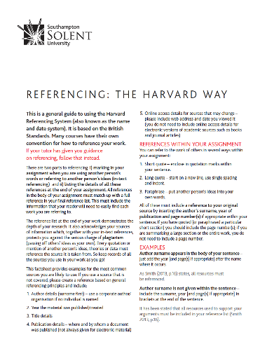

Slide 70
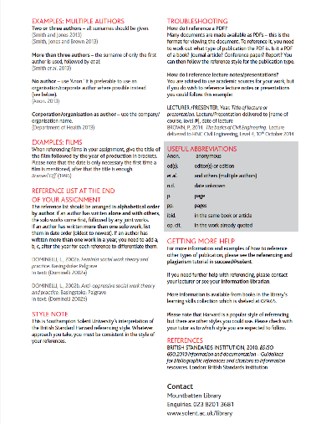

Slide 71
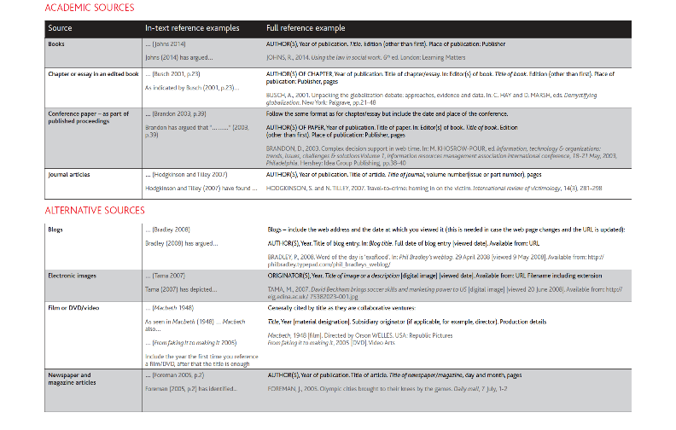

Slide 72
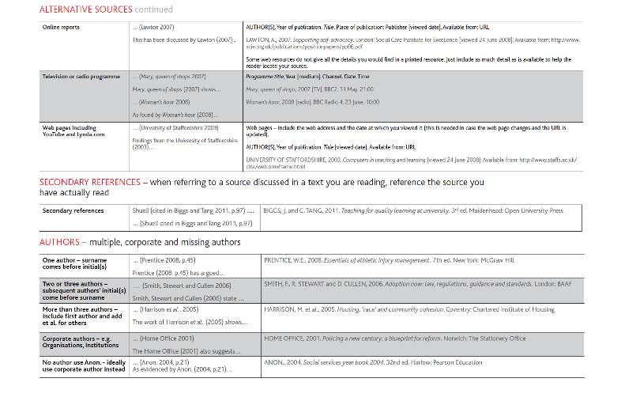

Slide 73
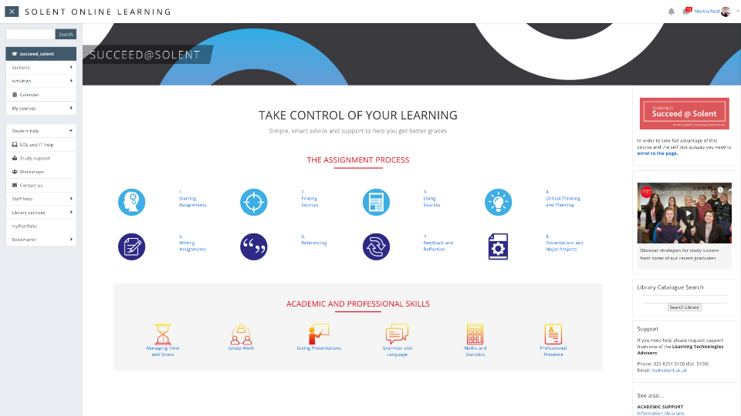
https://learn.solent.ac.uk/course/view.php?id=90

Slide 74
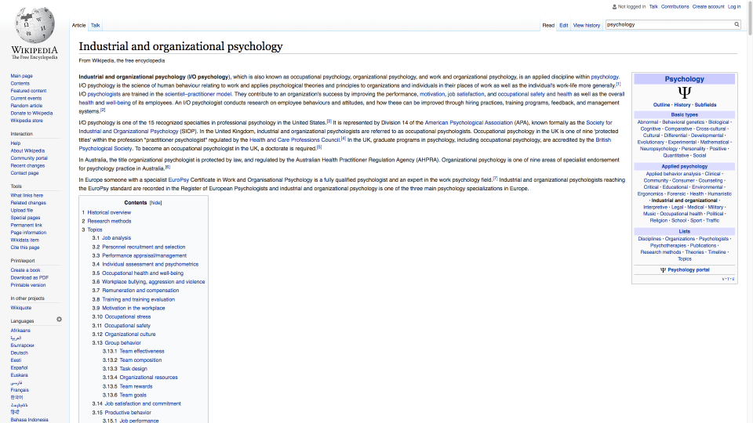
Notes:
Do not reference to wikipedia
https://en.wikipedia.org/wiki/Industrial_and_organizational_psychology

Slide 75
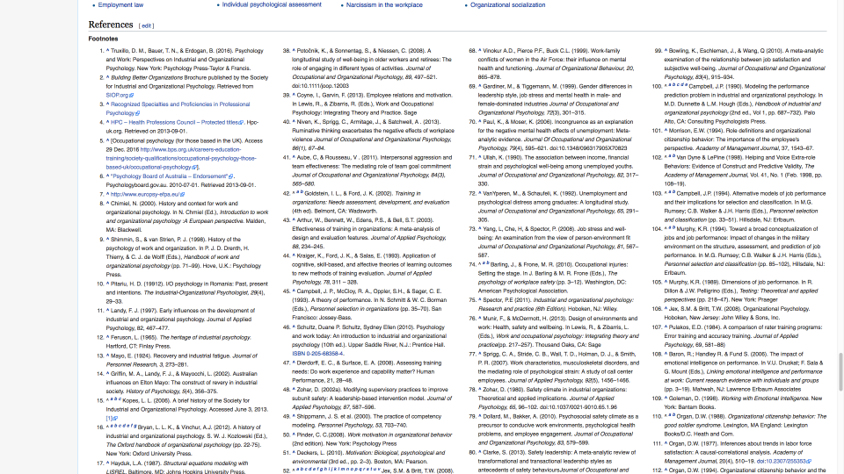
Notes:
But use the references to find original sources and references to them
https://en.wikipedia.org/wiki/Industrial_and_organizational_psychology

