Slide 1

academic misconduct
Part 1 - introduction
SOLENT UNIVERSITY - COMPUTING SUBJECT GROUP

Slide 2

Types of academic misconduct
1. Plagiarism
2. Collusion
3. Falsification
4. Replication
5. Exams & TCAs
Taking unauthorised notes or devices into an exam
Obtaining an unauthorised copy of an exam paper
Communicating with another student during an exam
Attempting to observe/copy another student's exam
Being a party to impersonation in relation to an exam
6. Providing assessments for academic misconduct
7. Failure to obtain/breach of ethical approval
8. Purchasing of essays from a third party
9. Submitting a fraudulent extenuating circumstances

Slide 3
1. PLAGIARISM
“where a student incorporates another person's or body's work by unacknowledged quotation, paraphrase, imitation or other device in any work submitted for assessment in a way which suggests that it is the student's original work”

Slide 4
2. COLLUSION
“knowingly allowing your work to be viewed by another student and this work is subsequently incorporated in the work of another student; or, the collaboration without official approval between students in the which is submitted as
the work of a single student”.

Slide 5
3. FALSIFICATION
“where the content of any assessed work has been invented or falsely presented by the student as their own work”

Slide 6
4. REPLICATION
“submitting the same or similar piece of work which has already been submitted for any assessment within the University or elsewhere. Students repeating an assessment, module or level are to produce new coursework except where the referral brief allows students to re-work a failed assessment”.

Slide 7
5. EXAMINATIONS
taking unauthorised notes or devices into an examination
obtaining an unauthorised copy of an examination paper
communicating, or trying to communicate, with another student or individual during an examination, or attempting to observe or copy another student’s written and/or electronic examination script
being a party to impersonation in
relation to an examination

Slide 8
6. PROVIDING ASSESSMENTS
…for the purpose of academic misconduct
“where a student sells to, writes or provides
assessments for another student”.

Slide 9
7. ETHICAL APPROVAL
“failure to obtain, or breach of ethical approval, where this is a requirement of the assessment”

Slide 10
8. PURCHASING
purchasing of essays from a third party

Slide 11
9. FRAUDULENT EC
submitting a fraudulent Extenuating Circumstances (EC) claim

Slide 12

SOLENT UNIVERSITY - COMPUTING SUBJECT GROUP
SOLENT UNIVERSITY - COMPUTING SUBJECT GROUP
SOLENT UNIVERSITY., 2020. Academic Handbook Section 4L: Student Academic Misconduct Procedure. viewed 27 April 2020]. Available from: https://students.solent.ac.uk/official-documents/quality-management/academic-handbook/4l-student-academic-misconduct-procedure.pdf

Slide 13
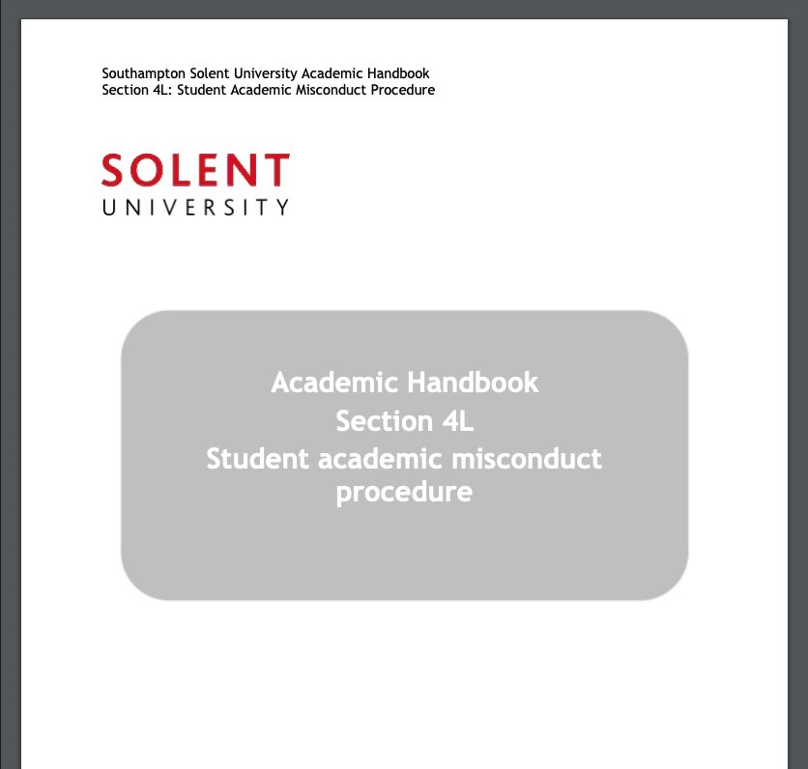
SOLENT UNIVERSITY., 2019. Academic Handbook Section 4L: Student Academic Misconduct Procedure. viewed 27 April 2020]. Available from: https://portal.solent.ac.uk/documents/academic-services/academic-handbook/section-4/4l-student-academic-misconduct-procedure.pdf?t=1587984215300

